Slide 1

Design for Safety and the Triple Bottom Line
Engineers Foundation of Ohio Fall CPD Conference
November 2, 2018
Mike Toole, PhD, PE (PA), F.ASCE
Dean, College of Engineering
University of Toledo
Based in part on past presentations with Dr. John Gambatese
Professor, Civil and Const. Engineering, Oregon State Univ.

Slide 2


Overview
Triple Bottom Line and Social Sustainability
We all have a Role to Play in Site Safety
DfS Concept and Benefits
Integrated Design and Construction
DfS Examples
DfS has Momentum
DfS Processes and Tools
Implementing DfS
Design for Safety (DfS)
= Prevention through Design (PtD)
Processes
Tools and equipment
Products
Work premises and facilities
Work methods and organization of work

Slide 3
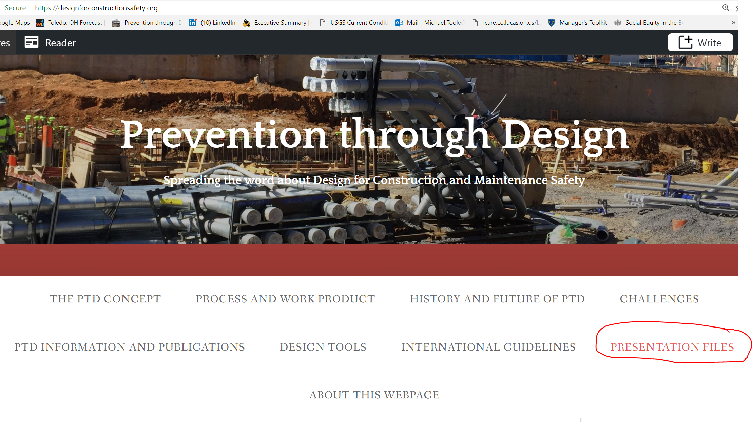

Slide 4

Triple Bottom Line
“All businesses can and must help society achieve three goals that are linked – economic prosperity, environmental protection and social equity.”

Slide 5
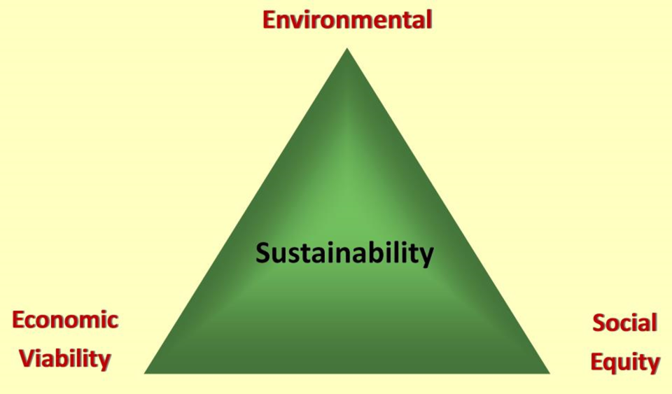
Sustainability and the Triple Bottom Line

Slide 6

Social sustainability
Definition of Sustainable Development in Brundtland Commission Report (1987)
Focus on people as much as on the environment
  Meet the needs of people who can’t speak for themselves

Slide 7
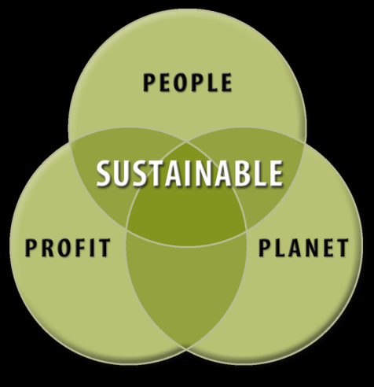
  Sustainable Development
Design and construction that doesn’t unfairly affect people who are not at the table
Further reading:
Toole, T. M. and G. Carpenter (2013). “Prevention through Design as a Path Towards Social Sustainability.” ASCE Journal of Architectural Engineering 19(3):169-173.

Slide 8
Social Sustainability issues
How will we convince all stakeholders that our project will not unfairly affect people who are not at the table during the concept development, design and construction planning?
  Building occupants
  Nearby residents
  Local politicians and regulators
  Our employees
  Construction workers
  Maintenance workers

Slide 9
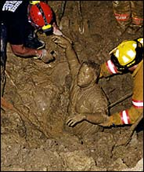
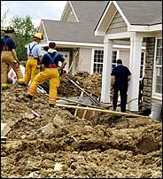
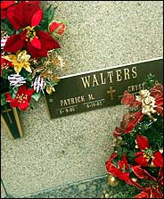
Annual Construction Accidents in U.S.
Nearly 200,000 serious injuries
1,000+ deaths

Slide 10
ASCE Code of Ethics
  Canon 1: Hold Safety Paramount
  Engineers shall hold paramount the safety, health and welfare of the public and shall strive to comply with the principles of sustainable development in the performance of their professional duties.
  a. Engineers shall recognize that the lives, safety, health and welfare of the general public are dependent upon engineering judgments, decisions and practices incorporated into structures, machines, products, processes and devices.

Slide 11
ASCE Site Safety Policy (350)
The American Society of Civil Engineers (ASCE) believes improving construction site safety requires attention and commitment from all parties involved.
Design engineers have responsibility for: Recognizing that safety and constructability are important considerations when preparing construction plans and specifications;
Educators are encouraged to: … Emphasize engineer's role in providing a safe and healthy environment to personnel engaged in project activities through proper planning and design; and

Slide 12
Social sustainability issues
Do not our duties include minimizing all risks (especially to people) that we have control over?
Do not we have the same duties for construction and maintenance workers as for the “public”?

Slide 13
Overview
Triple Bottom Line and Social Sustainability
We all have a Role to Play in Site Safety
DfS Concept and Benefits
Integrated Design and Construction
DfS Examples
DfS has Momentum
DfS Processes and Tools
Implementing DfS
Design for Safety (DfS)
= Prevention through Design (PtD)
Processes
Tools and equipment
Products
Work premises and facilities
Work methods and organization of work

Slide 14
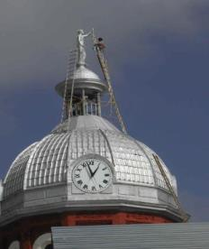
Prevention through Design (PtD)
“Addressing occupational safety and health needs in the design process to prevent or minimize the work-related hazards and risks associated with the construction, manufacture, use, maintenance, and disposal of facilities, materials, and equipment.”
(http://www.cdc.gov/niosh/topics/ptd/)

Slide 15
Design-safety links
22% of 226 injuries that occurred from 2000-2002 in Oregon, WA, and CA¹
42% of 224 fatalities in US between 1990-2003¹
60% of fatal accidents resulted in part from decisions made before site work began²
63% of all fatalities and injuries could be attributed to design decisions or lack of planning³
¹ Behm, M., “Linking Construction Fatalities to the Design for Construction Safety Concept” (2005)
² European Foundation for the Improvement of Living and Working Conditions
³ NSW WorkCover, CHAIR Safety in Design Tool, 2001

Slide 16
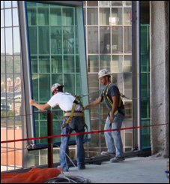
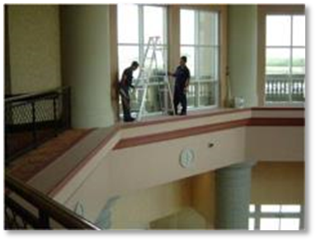
DfS in Construction is…
Explicitly considering construction and maintenance safety in the design of a project.
Being conscious of and valuing the safety of construction and maintenance workers when performing design tasks.
Making design decisions based in part on a design element's inherent safety risk to construction and maintenance workers.
“Safety Constructability and Maintainability”

Slide 17
What DfS in construction is NOT
Having designers take an active role in construction safety DURING construction.
An endorsement of future legislation mandating that designers design for construction safety.
An endorsement of the principle that designers can or should be held partially responsible for construction accidents.

Slide 18
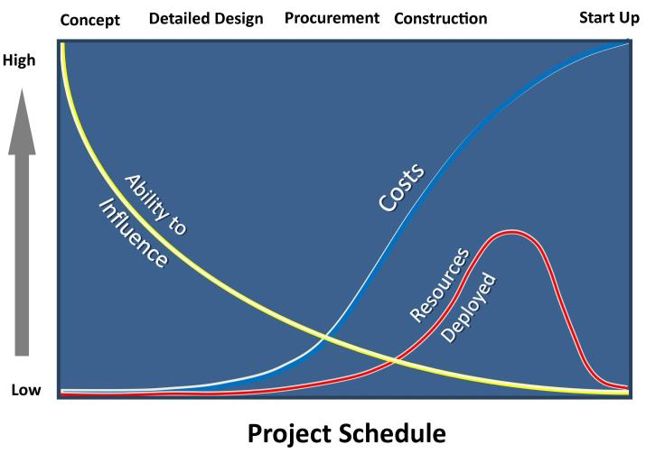
Design has major leverage
Ability to influence key project goals is greatest early in the project schedule during planning and design (Szymberski, 1997)

Slide 19
Integrated Design and Construction
Project success requires that design reflects input from all stakeholders, including:
  Users/occupants
  Owner facility management personnel
  Contractors
Constructability feedback must start early in the design process

Slide 20
When Safety is Not Discussed during Design
Users/Occupants can be hurt.
  Example: Kansas City Hyatt, Luke Bresette
Designs are unconstructable.
  Example: high school masonry wall collapse
Designs are more hazardous to construct than they need to be.
  Examples: excavation, superstructure, MEP, finishes…
Designs are more hazardous to maintain than they need to be.
  Examples: skylights, access to light bulbs, valves.…

Slide 21
Benefits of Integrated Design and Construction
Obvious: Cost, Schedule, Quality
Accepted: Sustainability
Emerging: Prefabrication
Emerging: Safety

Slide 22
Hierarchy of Controls
Elimination
Eliminate the hazard during design
Prevention through Design
Higher
Substitution
Substitute a less-hazardous material or form during design
Reliability of Control
Engineering Controls
“Design-in” engineering controls,
Incorporate warning systems
Administrative Controls
Well-designed work
methods & organization
PPE
Available, effective,
easy to use
Lower

Slide 23
Economic benefits of DfS
Reduced site hazards
  Fewer worker injuries and fatalities
Reduced workers’ compensation premiums
Increased productivity and quality
Fewer delays due to accidents
Improved operations/maintenance safety

Slide 24
Overview
Triple Bottom Line and Social Sustainability
We all have a Role to Play in Site Safety
DfS Concept and Benefits
Integrated Design and Construction
DfS Examples
DfS has Momentum
DfS Processes and Tools
Implementing DfS
Design for Safety (DfS)
= Prevention through Design (PtD)
Processes
Tools and equipment
Products
Work premises and facilities
Work methods and organization of work

Slide 25
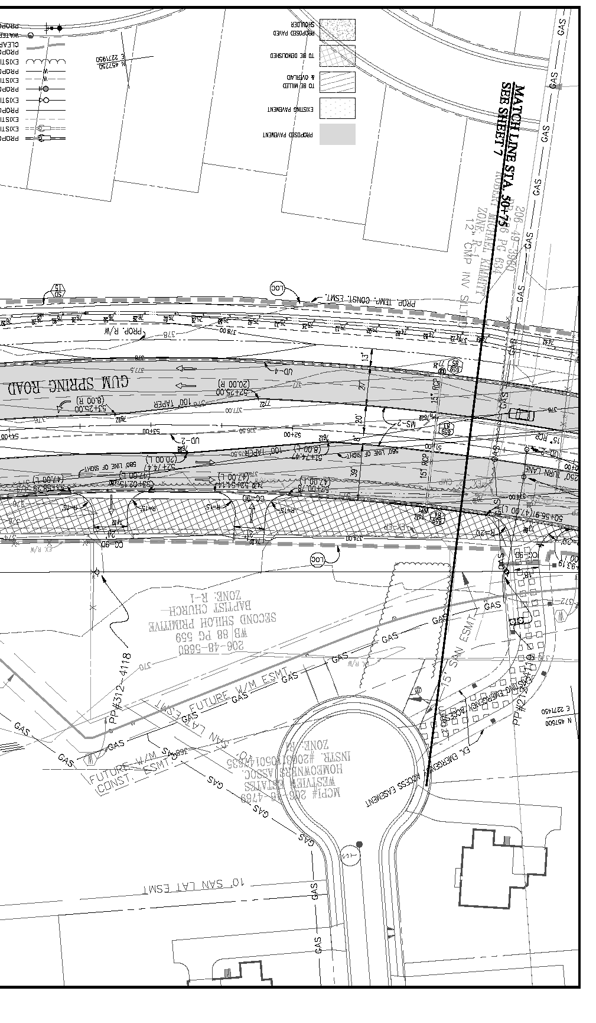
Example of the Need for DfS
Design spec:
  Dig groundwater monitoring wells at various locations.
  Wells located directly under overhead power lines.
Accident:
  Worker electrocuted when his drill rig got too close to overhead power lines.
Engineer could have:
  specified wells be dug away from power lines; and/or
  better informed the contractor of hazard posed by wells’ proximity to powerlines through the plans, specifications, and bid documents.

Slide 26
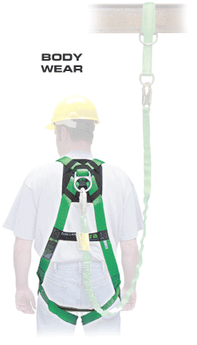
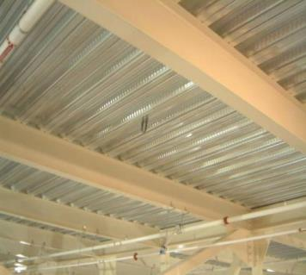
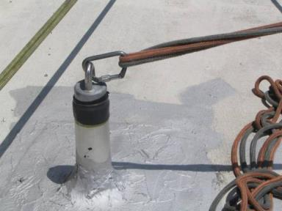
DfS Example: Anchorage Points
Notes:
Identifying and/or designing needed anchorage points for fall protection systems such as body harnesses and lanyards is an example of how designers can use their understanding of structural engineering principles to make it easier for workers to use fall protections systems efficiently, both during construction and future maintenance. Specifically, designers can:
Design floor perimeter beams and beams above floor openings to support lanyards
Design lanyard connection points along the beams
Note on the contract drawings which beams are designed to support lanyards, how many lanyards, and at what locations along the beams.
The idea of identifying anchorage points on construction drawings is in accordance with Appendix C to Subpart M (Fall Protection) from the federal OSHA standards for Construction:
(h) Tie-off considerations (1) “One of the most important aspects of personal fall protection systems is fully planning the system before it is put into use. Probably the most overlooked component is planning for suitable anchorage points. Such planning should ideally be done before the structure or building is constructed so that anchorage points can be incorporated during construction for use later for window cleaning or other building maintenance. If properly planned, these anchorage points may be used during construction, as well as afterwards.”

Slide 27
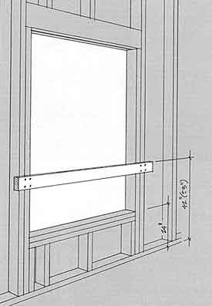
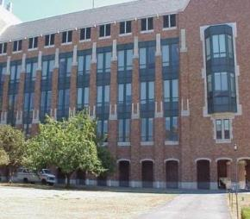
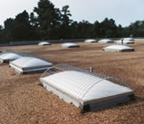
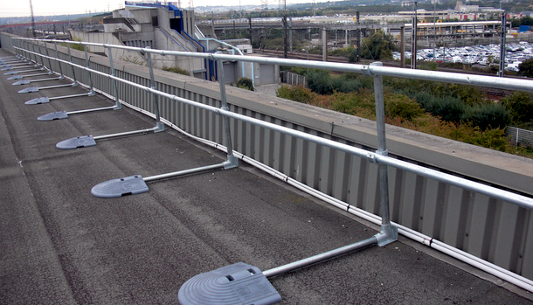
DfS Example: Roofs and Perimeters
Upper story windows
Skylights
Parapet walls
https://cdn.simplifiedsafety.com/images/parapet-railing/non-penetrating-parapet-railing.jpg

Slide 28
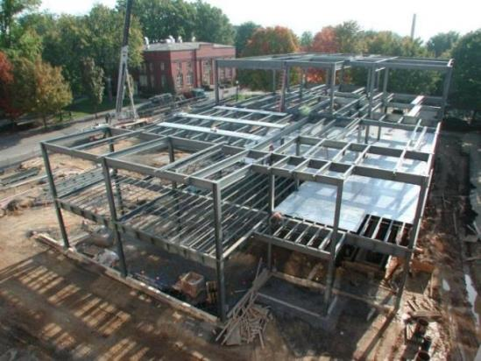
DfS Example: Structural Steel Design
Detailing Guide for the Enhancement of Erection Safety
Published by the National Institute for Steel Detailing and the Steel Erectors Association of America

Slide 29
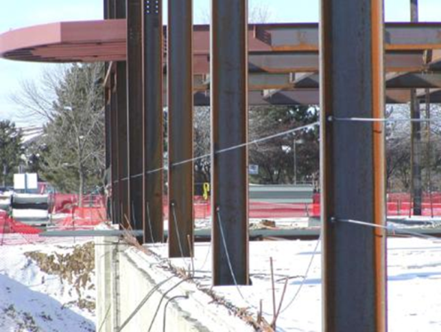
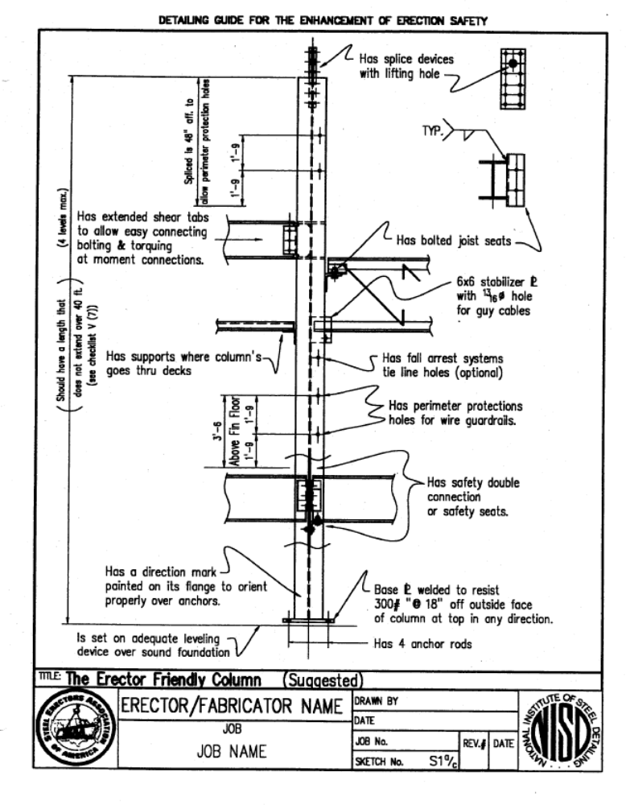
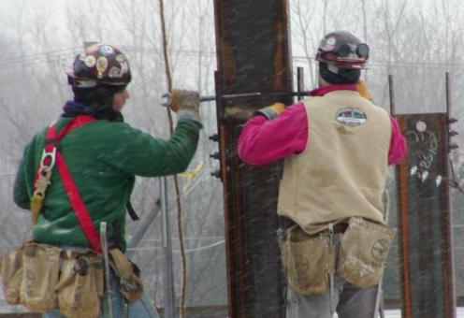
The Erector Friendly Column
  Include holes in columns at 21” and 42” for guardrail cables and at higher locations for fall protection tie-offs
  Locate column splices and connections at reasonable heights above floor
Photo: AISC educator ppt

Slide 30
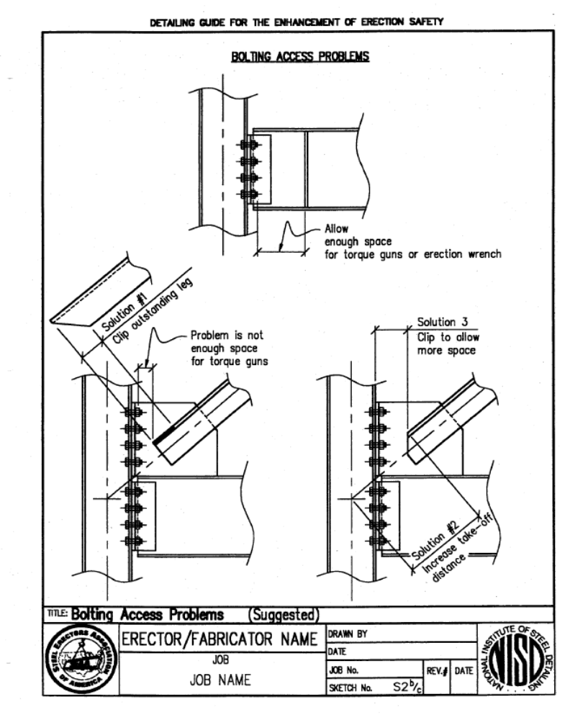
Provide enough space for making connections

Slide 31
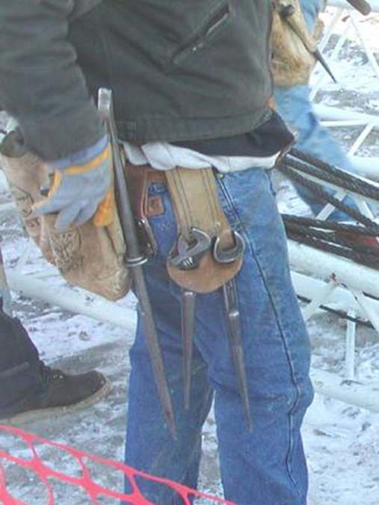
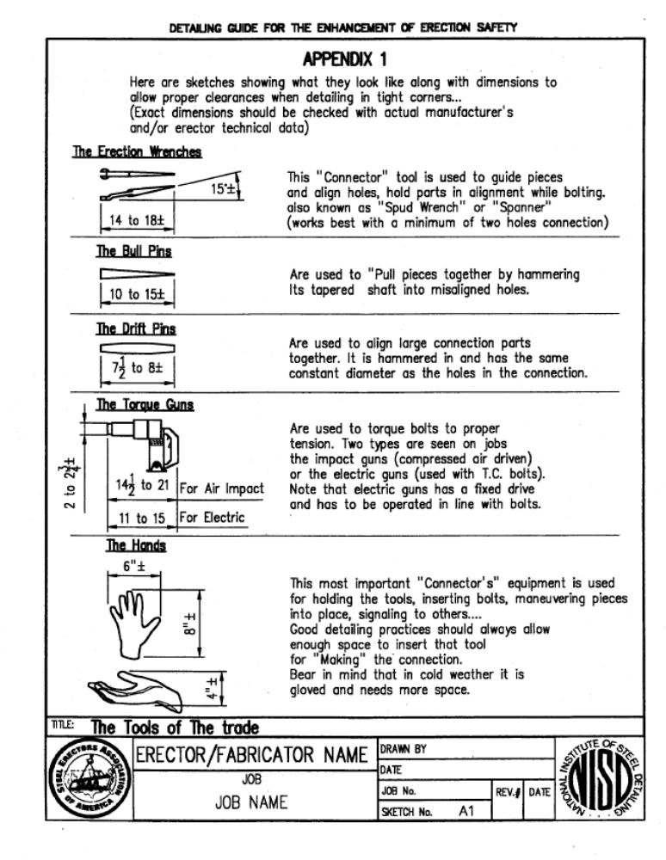
Know approximate dimensions of necessary tools to make connections
Photo: AISC educator ppt

Slide 32
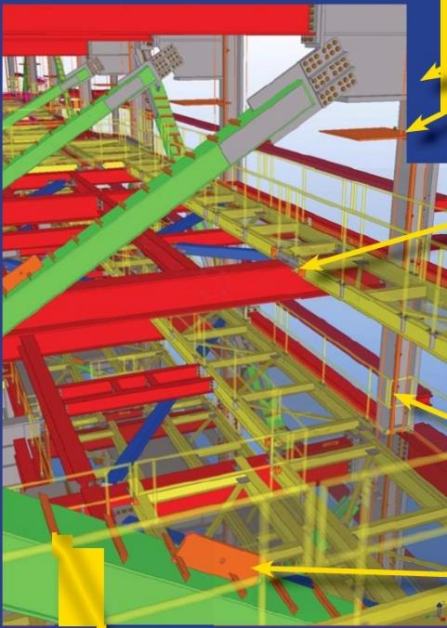
DfS Example – Steel Design
Bechtel’s steel design process
DfS elements:
  Temporary access platforms
  Lifting lugs
  Shop installed vertical brace ladders
  Bolt-on column ladders and work platforms

Slide 33
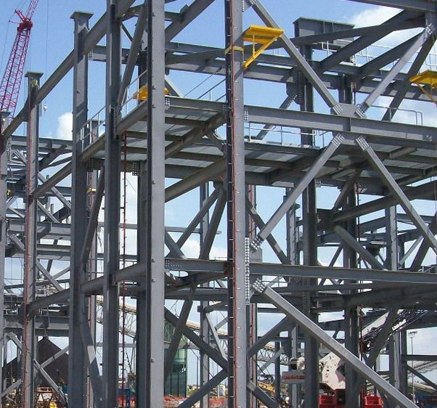
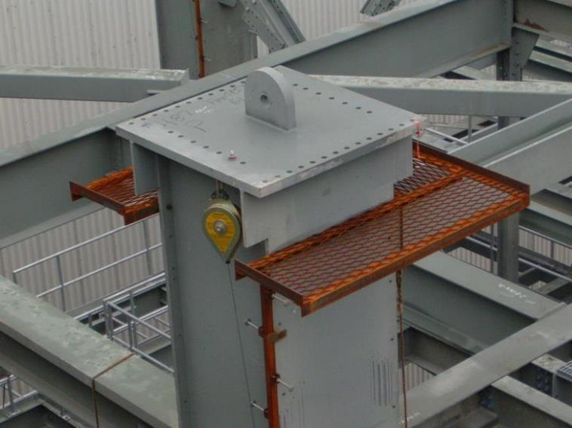
Temporary Ladder, Platform, and Safety Line
Photos courtesy of Bechtel Corp.

Slide 34
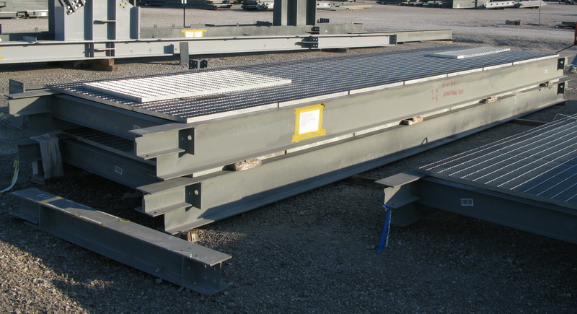
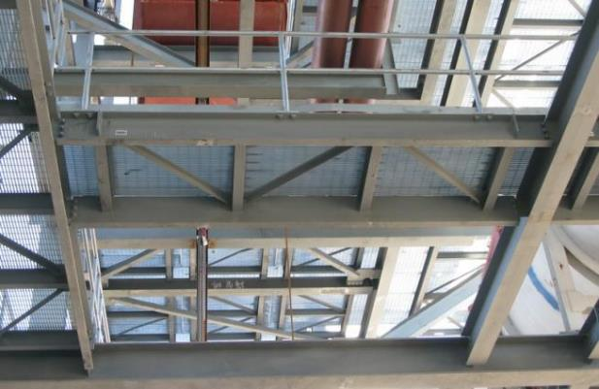
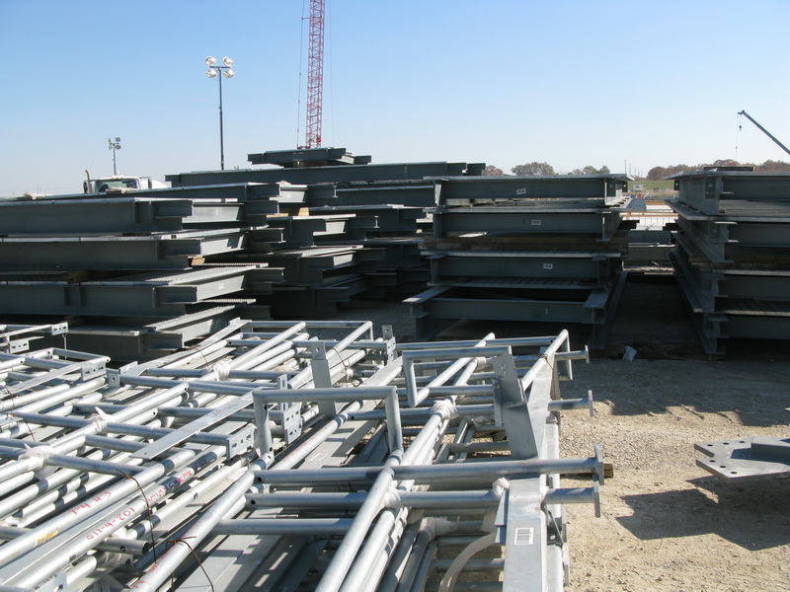
Modular Platforms
Photos courtesy of Bechtel Corp.

Slide 35
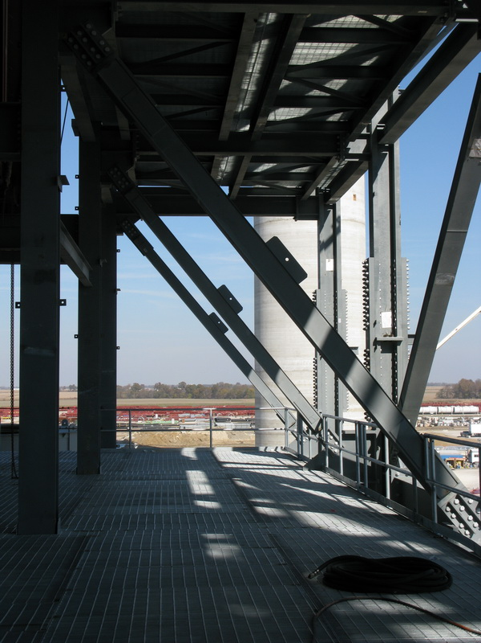
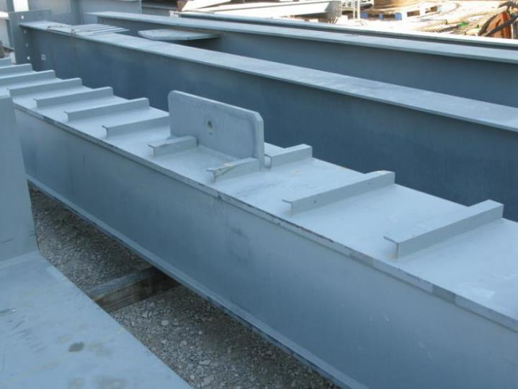
Brace Lifting Clips and Rungs
Photos courtesy of Bechtel Corp.

Slide 36
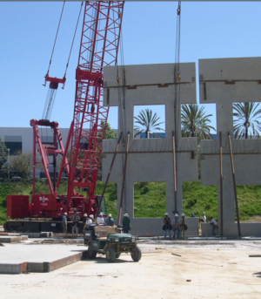
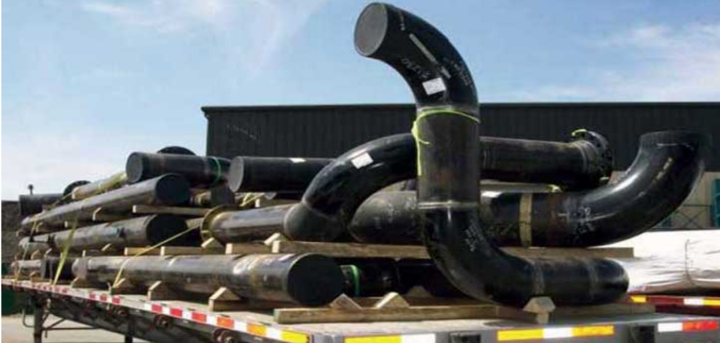
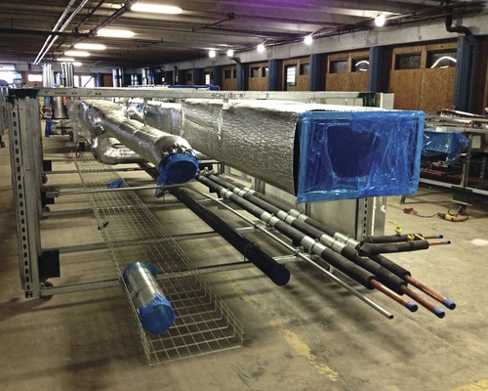
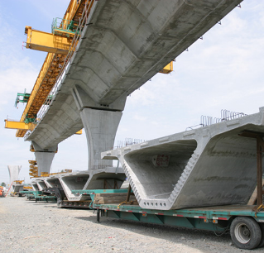
DfS and Prefabrication
Concrete Wall Panels
Pipe Spools
www.wermac.org/documents/fabrication_shop.html
MEP Corridor Racks
Concrete Segmented Bridge

Slide 37
Prefabrication: the link between environmental sustainability and safety
Prefabricated construction is inherently safer than “stick-built.”
Work is shifted from dangerous work environments to engineered work environments and processes.
  at height
  in trenches
  in confined spaces
  exposed to weather (wind, water, ice, mud, lightning)
Prefabricated construction has
  lower construction waste
  lower embodied energy
  lower embodied greenhouse gases

Slide 38
Design for maintenance safety
Provide safe access for recurring maintenance/preventive maintenance
  Light Bulbs, Air Filters, Belts, Valves
  At height, confined space, awkward ergonomics
Provide safe clearance for replacing units
  Blower Units, Boilers, Compressors, Pumps
  Isolation, Material handling, Path out and in

Slide 39
What do you think?
What do you think about the Triple Bottom Line concept?
Do codes of ethics apply to construction and maintenance workers?
What do you think about the Design for Safety concept?
What are your experiences in design for safe construction and design for safe maintenance?

Slide 40
Overview
Triple Bottom Line and Social Sustainability
We all have a Role to Play in Site Safety
DfS Concept and Benefits
Integrated Design and Construction
DfS Examples
DfS has Momentum
DfS Processes and Tools
Implementing DfS
Design for Safety (DfS)
= Prevention through Design (PtD)
Processes
Tools and equipment
Products
Work premises and facilities
Work methods and organization of work

Slide 41
DfS is gaining momentum
Required in UK, Europe for since 1995
Required in Australia, S. Africa, Singapore
OSHA DfCS Workgroup since 2005
NIOSH PtD Workshops and Funding
Adoption primarily in the process/industrial construction sector

Slide 42
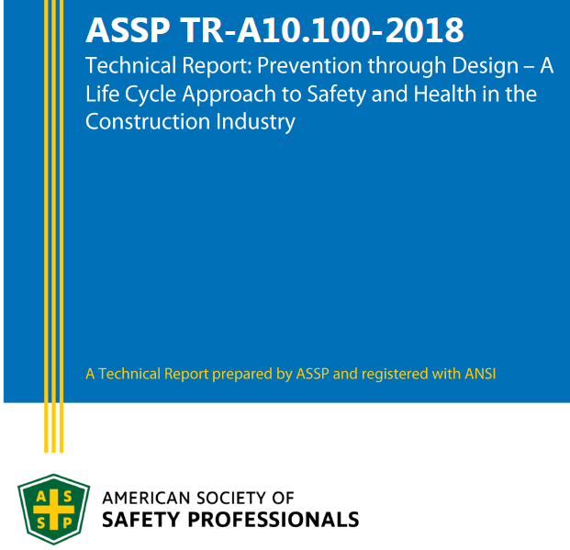

ANSI Documents

Slide 43
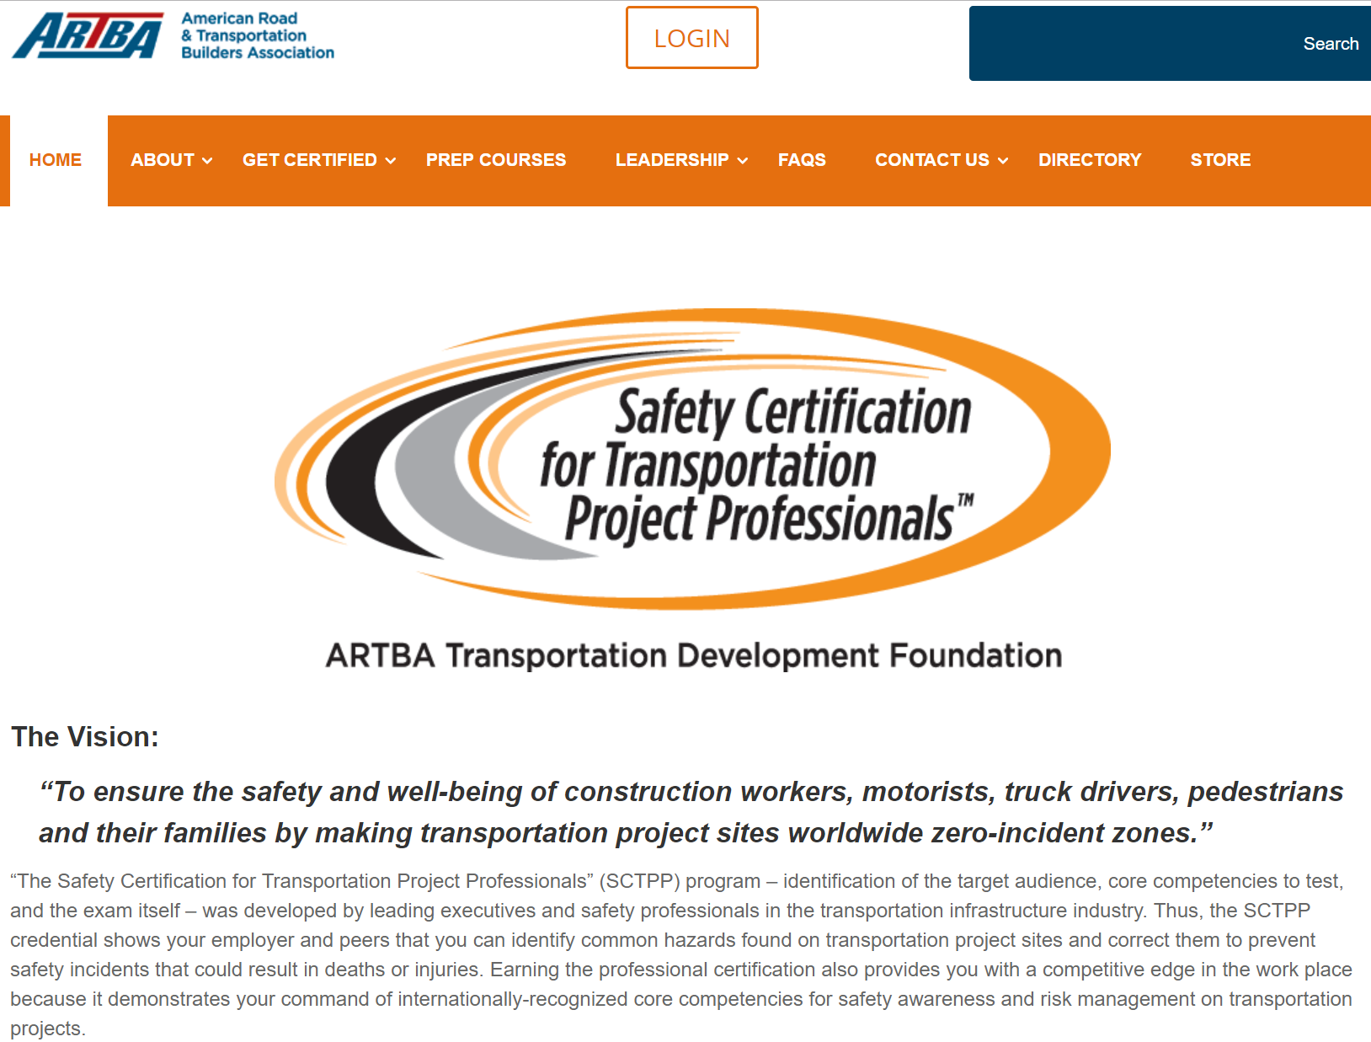

Slide 44
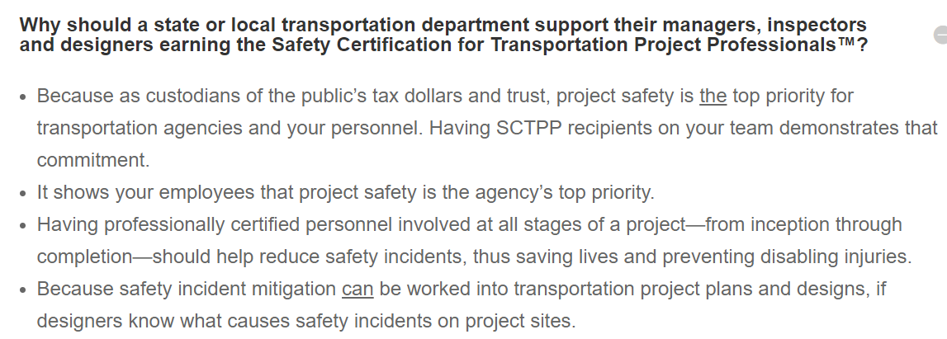
ARTBA Safety Certification FAQ
https://puttingsafetyfirst.org/

Slide 45
LEED PtD pilot credit
Identify and document the items found for the following two stages:
  Operations and Maintenance
  Construction
For each stage, complete three stages of analysis:
  Baseline
  Discovery
  Implementation

Slide 46
DfS in Practice: Owners
Southern Co. (power)
Intel (computer chips)
San Fran. Public Utilities Commission (water infrastructure)
Marine Well Containment System (Gulf Oil Drilling)
US Army Corps of Engineers (Water Infrastructure)
BHP Billiton (Mining)
Notes:
Southern Co: Developed project/equipment-specific and engineering discipline-specific checklists for maintenance that have grown to include construction safety. Safety and construction personnel required to be involved in several design stages. Engineers being trained in safety.
Intel: Has lifecycle safety checklist for all projects. Willing to make major footprint changes, as we saw by adding new floor.
Ellen Stewart at USACE: Intentions but progress limited by focus on completing revised EM 385. PtD and safety promotion to engineering and construction groups and 3 hours of training. She hopes to add anchorage points design to EM 385, processes.
ExxonMobil: Initiated Engineering for Safety Process as part of their Marine Well Containment System (MWCS) project.
Sutter Health: Set up Integrated Project Delivery (IPD) on one of its hospital projects in San Francisco. Co-located owner, designer, CM/GC, and trade contractor firms. IPD process allowed for PtD to occur.

Slide 47
BHP Billiton’s DfS Initiatives
Design reviews includes 3D models
DfS staff embedded in procurement and design
DfS in technical specifications
Required designer DfS training

Slide 48
Overview
Triple Bottom Line and Social Sustainability
We all have a Role to Play in Site Safety
DfS Concept and Benefits
Integrated Design and Construction
DfS Examples
DfS has Momentum
DfS Processes and Tools
Implementing DfS
Design for Safety (DfS)
= Prevention through Design (PtD)
Processes
Tools and equipment
Products
Work premises and facilities
Work methods and organization of work

Slide 49
DfS Design Review
Hazard identification
  What construction safety hazards does the design create?
Risk assessment
  What is the level of safety and health risk associated with each hazard?
Design option identification and selection
  What can be done to eliminate or reduce the risk?
  Remember the hierarchy of controls……

Slide 50
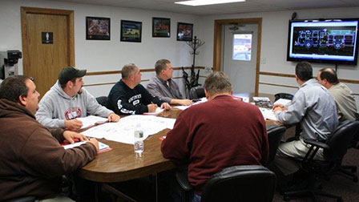
DfS Process
Get the right people
talking about the right things
at the right time!
www.seagrave.com/

Slide 51
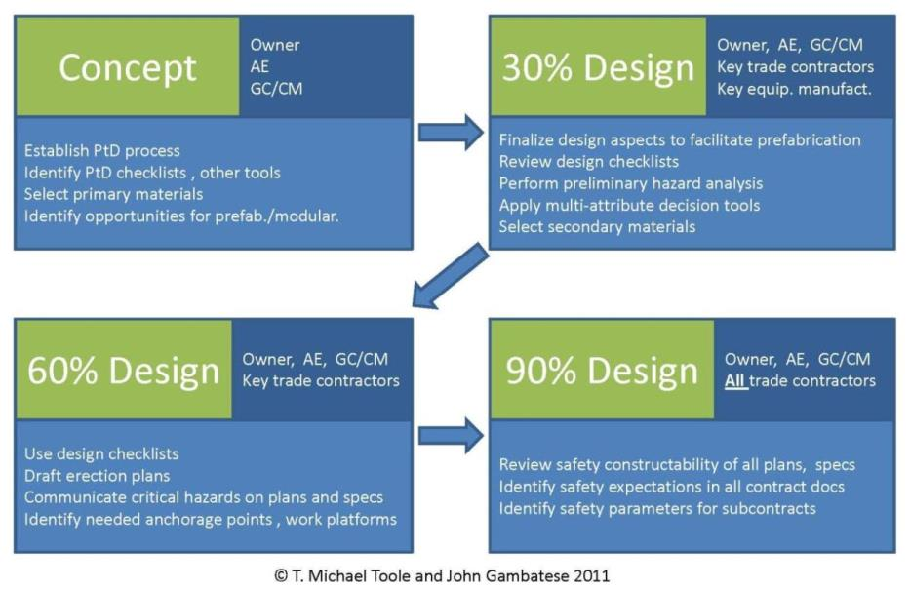
DfS Process

Slide 52
Sutter Health’s IPD Process
Integrated Project Delivery (IPD) facilitates collaboration of design and construction professionals during design
  Co-located
  Processes and norms for candid feedback
  Trust
  Sufficient time
  Life cycle costing criteria
  Common success criteria

Slide 53
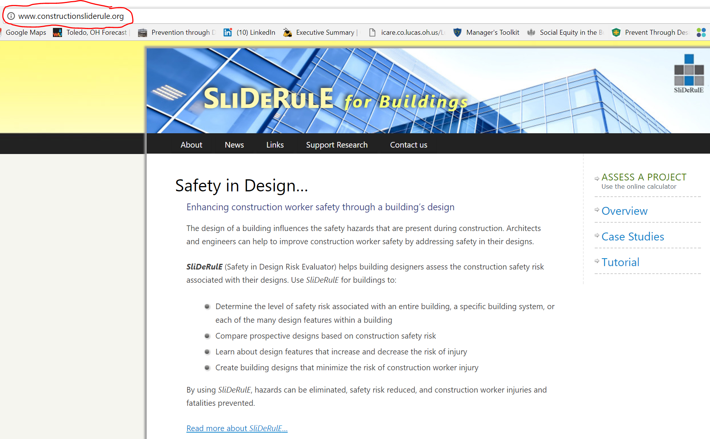
DfS Tools – Design Risk Assessment
www.constructionsliderule.org

Slide 54
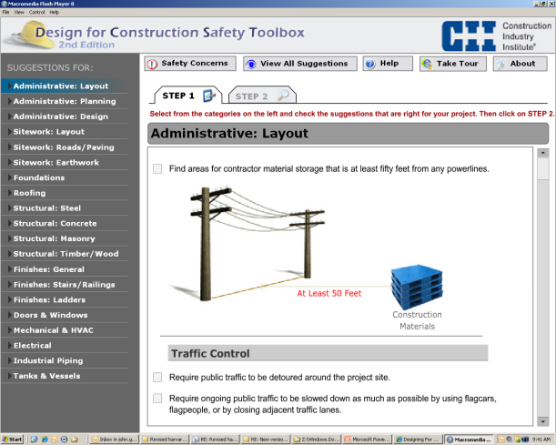
Design for Construction Safety Toolbox
Created by Construction Industry Institute (CII)
Interactive computer program
Used in the design phase to decrease the risk of incidents
Over 400 design suggestions

Slide 55
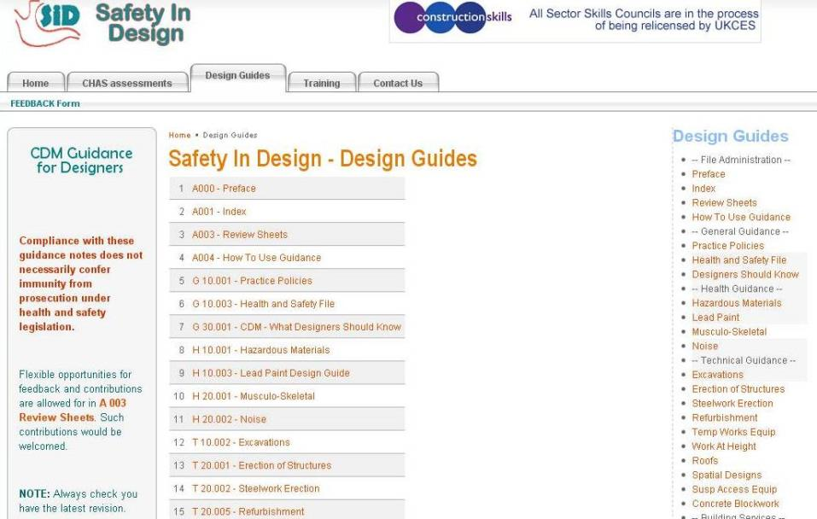

Slide 56
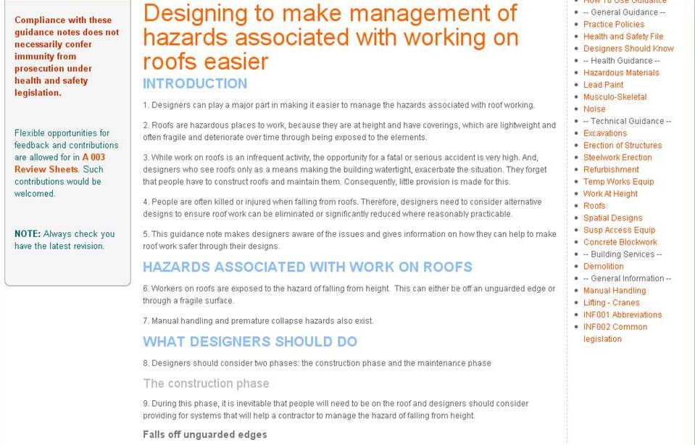

Slide 57
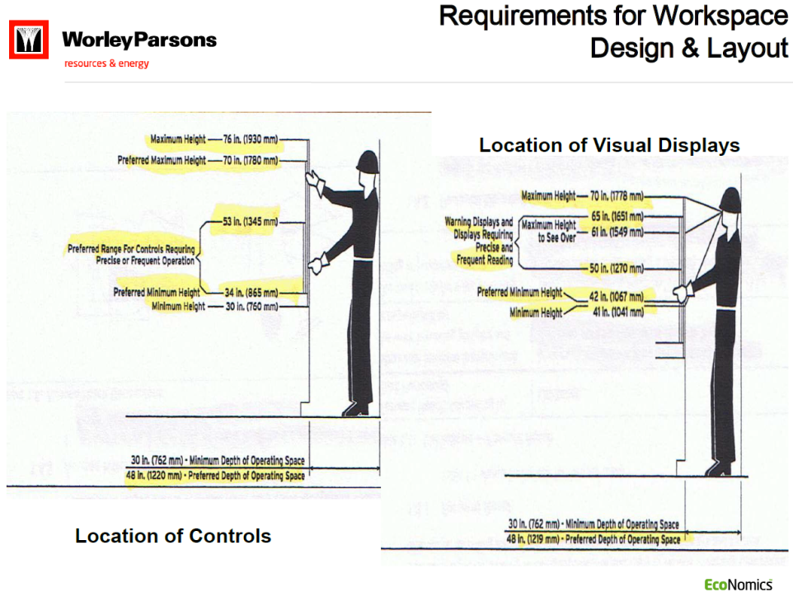

Slide 58
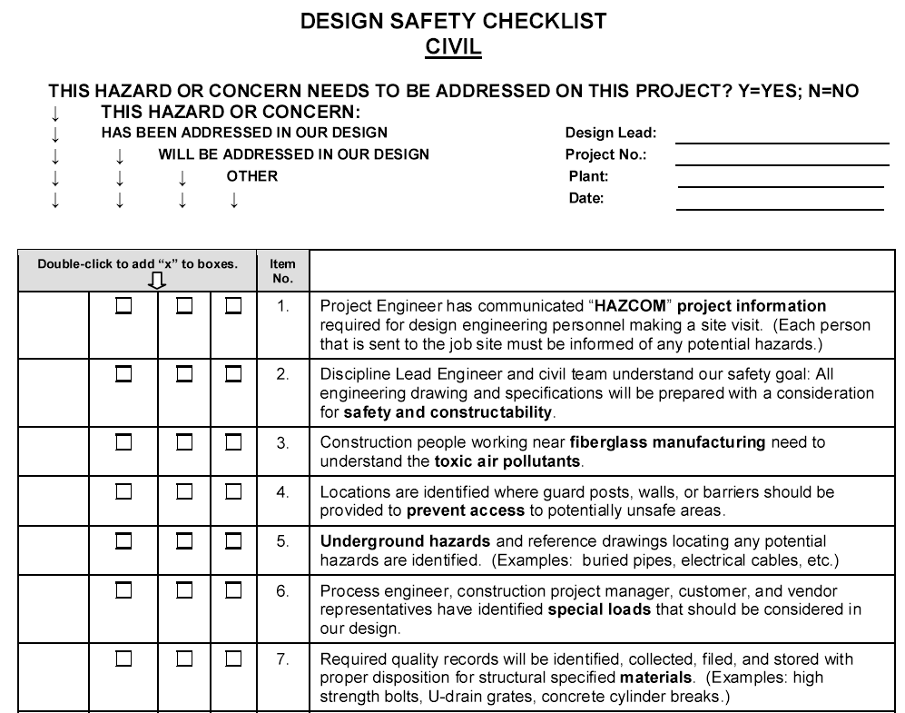
Southern Co.’s Design checklists

Slide 59
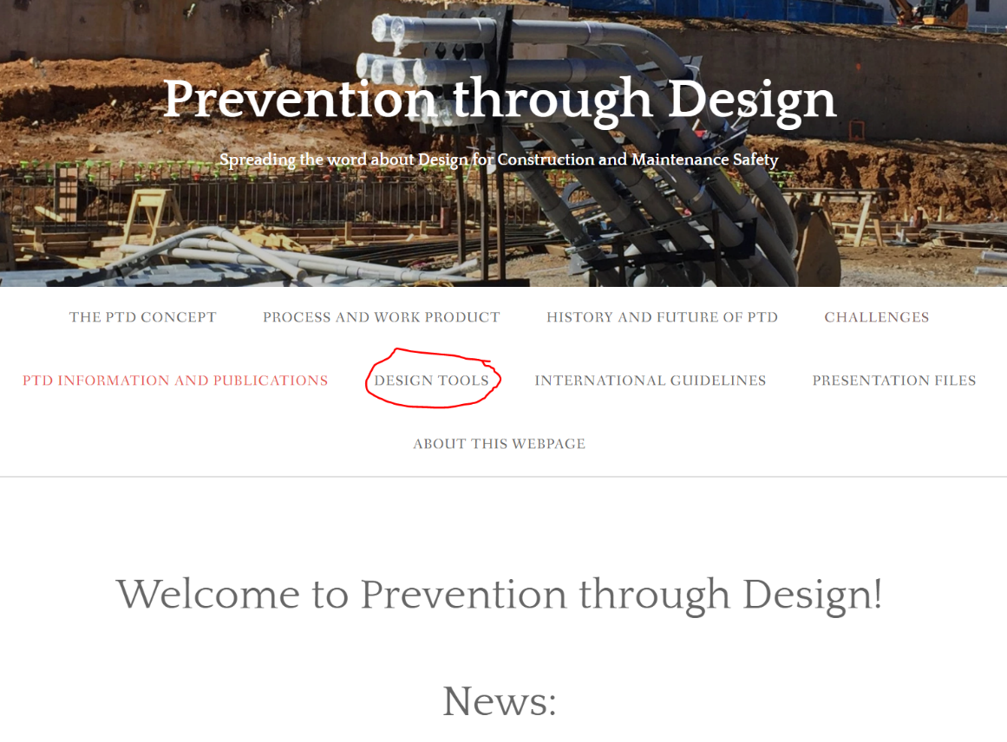
DfS information sources
www.designforconstructionsafety.org

Slide 60
1700+ Item DfS Checklist
Item | Description
1.0 | Structural Framing
1.1 | Space slab and mat foundation top reinforcing steel at no more than 6 inches on center each way to provide a safe walking surface.
1.2 | Design floor perimeter beams and beams above floor openings to support lanyards.
1.3 | Design steel columns with holes at 21 and 42 inches above the floor level to support guardrail cables.
2.0 | Accessibility
2.1 | Provide adequate access to all valves and controls.
2.2 | Orient equipment and controls so that they do not obstruct walkways and work areas.
2.3 | Locate shutoff valves and switches in sight of the equipment which they control.
2.4 | Provide adequate head room for access to equipment, electrical panels, and storage areas.
2.5 | Design welded connections such that the weld locations can be safely accessed.

Slide 61
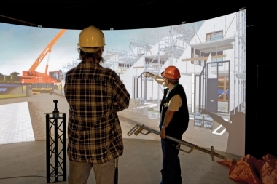

DfS Tools – BIM and Visualization

Slide 62
Overview
Triple Bottom Line and Social Sustainability
We all have a Role to Play in Site Safety
DfS Concept and Benefits
Integrated Design and Construction
DfS Examples
DfS has Momentum
DfS Processes and Tools
Implementing DfS
Design for Safety (DfS)
= Prevention through Design (PtD)
Processes
Tools and equipment
Products
Work premises and facilities
Work methods and organization of work

Slide 63
Three Steps towards DfS
Establish a lifecycle safety culture
Establish enabling processes
Team with organizations who value lifecycle safety
Culture
Processes
Partners

Slide 64
Establish a Lifecycle Safety Culture
Secure management commitment to safety and to a life cycle approach
Instill the right safety values
Training
Ensure recognition that designing for safety is the smart thing to do and the right thing to do
  Professional Codes of Ethics
  Payoff data

Slide 65

Establish Enabling Processes
Qualifications-based contracting
Negotiated or Cost-Plus contracting
IPD or enabled safety constructability input
Collaborative decision processes
Designer training and tools

Slide 66
Choose your partners wisely
DfS capability in designer RFP
Designer interaction experience in GC RFP
Consider Design-Builders with industrial and international project experience
Collaborative culture and experiences
Open to change

Slide 67
What each entity needs to do to enable DfS 1
Owner
  Require DfS on projects
  Allow project delivery methods other than DBB
  Involve construction and maintenance safety staff in constructability reviews
AE
  Acquire DfS capability
  Work on DfS projects
  Participate in safety constructability discussions and revise project documents as appropriate

Slide 68
What each entity needs to do to enable DfS 2
GC/CM and Subcontractors
  Encourage clients to require DfS on projects
  Collaborate with owner and staff on constructability reviews
  Persist if safety is not prioritized

Slide 69
Initiating DfS in your organization
Leadership
Sustainability
Ethics
Innovation
Change management

Slide 70
Summary
Our clients and taxpayers may increasingly be demanding that we deliver integrated design and construction and proactively consider the triple bottom line on our projects.
Design for Safety is a promising way to achieve economic, social and environmental sustainability and increase safety and health.
Management commitment, training and client engagement are necessary first steps.
DfS can be an important part of achieving your organization’s safety goals.

Slide 71

THANK YOU FOR YOUR TIME!
Mike Toole
michael.toole@utoledo.edu
www.designforconstructionsafety.org

