Slide 1

the Triple Bottom Line in Capital Projects
Maumee Valley OSPE
May 15, 2018
Mike Toole, PhD, PE, F.ASCE
Dean, College of Engineering
Professor, Civil & Env. Engineering

Slide 2


Overview
Triple Bottom Line and Social Sustainability
Improving Site Safety requires Integrated Design and Construction
PtD Concept and Benefits
Examples
Processes and Tools
Moving forward in your organization
Prevention through Design
= Design for Safety
= Safety by Design
Processes
Tools and equipment
Products
Work premises and facilities
Work methods and organization of work

Slide 3

Triple Bottom Line
“All businesses can and must help society achieve three goals that are linked – economic prosperity, environmental protection and social equity.”
http://blueandgreentomorrow.com/features/book-review-cannibals-with-forks-john-elkington-1999/

Slide 4
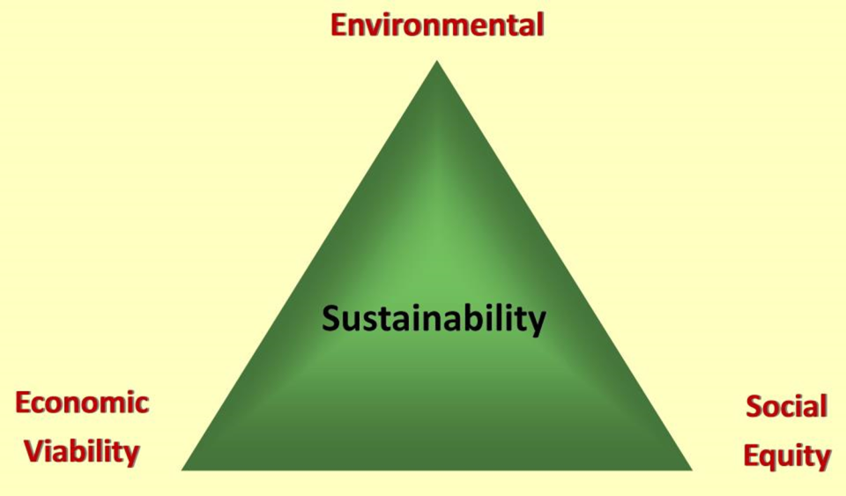
Sustainability and the Triple Bottom Line

Slide 5

Social sustainability
Definition of Sustainable Development in Brundtland Commission Report (1987)
Focus on people as much as on the environment
  Meet the needs of people who can’t speak for themselves

Slide 6
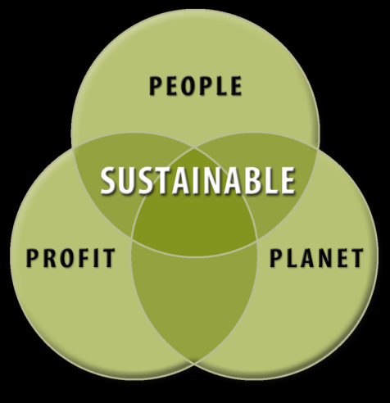
  Sustainable Development
Design and construction that doesn’t unfairly affect people who are not at the table
Further reading:
Toole, T. M. and G. Carpenter (2013). “Prevention through Design as a Path Towards Social Sustainability.” ASCE Journal of Architectural Engineering 19(3):169-173.

Slide 7
Social Sustainability issues
How will we convince all stakeholders that our project will not unfairly affect people who are not at the table during the concept development, design and construction planning?
  Building occupants
  Nearby residents
  Local politicians and regulators
  Our employees
  Construction workers
  Maintenance workers

Slide 8
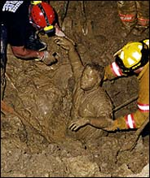
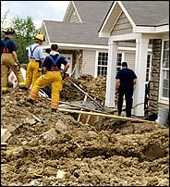
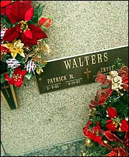
Annual Construction Accidents in U.S.
Nearly 200,000 serious injuries
1,000+ deaths

Slide 9
Design-safety links
22% of 226 injuries that occurred from 2000-2002 in Oregon, WA, and CA¹
42% of 224 fatalities in US between 1990-2003¹
60% of fatal accidents resulted in part from decisions made before site work began²
63% of all fatalities and injuries could be attributed to design decisions or lack of planning³
¹ Behm, M., “Linking Construction Fatalities to the Design for Construction Safety Concept” (2005)
² European Foundation for the Improvement of Living and Working Conditions
³ NSW WorkCover, CHAIR Safety in Design Tool, 2001

Slide 10
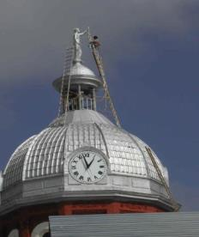
Prevention through Design (PtD)
“Addressing occupational safety and health needs in the design process to prevent or minimize the work-related hazards and risks associated with the construction, manufacture, use, maintenance, and disposal of facilities, materials, and equipment.”
(http://www.cdc.gov/niosh/topics/ptd/)

Slide 11
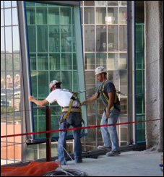
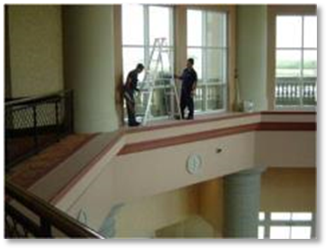
PtD in Construction is…
Explicitly considering construction and maintenance safety in the design of a project.
Being conscious of and valuing the safety of construction and maintenance workers when performing design tasks.
Making design decisions based in part on a design element's inherent safety risk to construction and maintenance workers.
“Safety Constructability and Maintainability”

Slide 12
Integrated Design and Construction
Project success requires that design reflects input from all stakeholders, including:
  Users/occupants
  Owner facility management personnel
  Contractors
Constructability feedback must start early in the design process

Slide 13
Benefits of Integrated Design and Construction
Obvious: Cost, Schedule, Quality
Accepted: Sustainability
Emerging: Prefabrication
Emerging: Safety

Slide 14
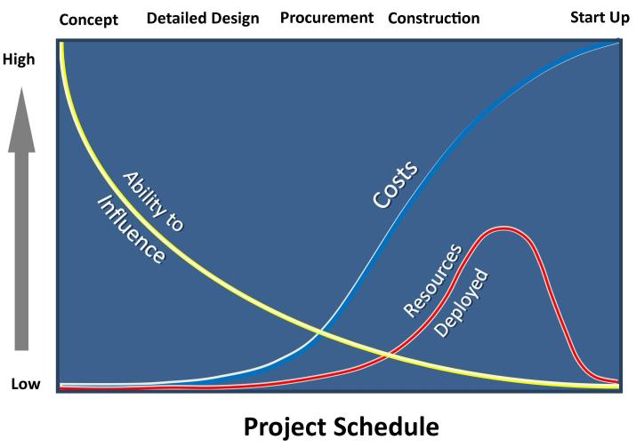
Design has major leverage
Ability to influence key project goals is greatest early in the project schedule during planning and design (Szymberski, 1997)

Slide 15
Hierarchy of Controls
Elimination
Eliminate the hazard during design
Prevention through Design
Higher
Substitution
Substitute a less-hazardous material or form during design
Reliability of Control
Engineering Controls
“Design-in” engineering controls,
Incorporate warning systems
Administrative Controls
Well-designed work
methods & organization
PPE
Available, effective,
easy to use
Lower

Slide 16
When Safety is Not Discussed during Design
Users/Occupants can be hurt.
  Example: Kansas City Hyatt, Luke Bresette
Designs are unconstructable.
  Example: high school masonry wall collapse
Designs are more hazardous to construct than they need to be.
  Examples: excavation, superstructure, MEP, finishes…
Designs are more hazardous to maintain than they need to be.
  Examples: skylights, access to light bulbs, valves.…

Slide 17
Economic benefits of Ptd
Reduced site hazards
  Fewer worker injuries and fatalities
Reduced workers’ compensation premiums
Increased productivity and quality
Fewer delays due to accidents
Improved operations/maintenance safety

Slide 18
ASCE Code of Ethics
  Canon 1: Hold Safety Paramount
  Engineers shall hold paramount the safety, health and welfare of the public and shall strive to comply with the principles of sustainable development in the performance of their professional duties.
  a. Engineers shall recognize that the lives, safety, health and welfare of the general public are dependent upon engineering judgments, decisions and practices incorporated into structures, machines, products, processes and devices.

Slide 19
Social sustainability issues
Do not our duties include minimizing all risks (especially to people) that we have control over?
Do not we have the same duties for construction and maintenance workers as for the “public”?

Slide 20
Overview
Triple Bottom Line and Social Sustainability
Improving Site Safety requires Integrated Design and Construction
PtD Concept and Benefits
Examples
Processes and Tools
Moving forward in your organization
Prevention through Design
= Design for Safety
= Safety by Design
Processes
Tools and equipment
Products
Work premises and facilities
Work methods and organization of work

Slide 21
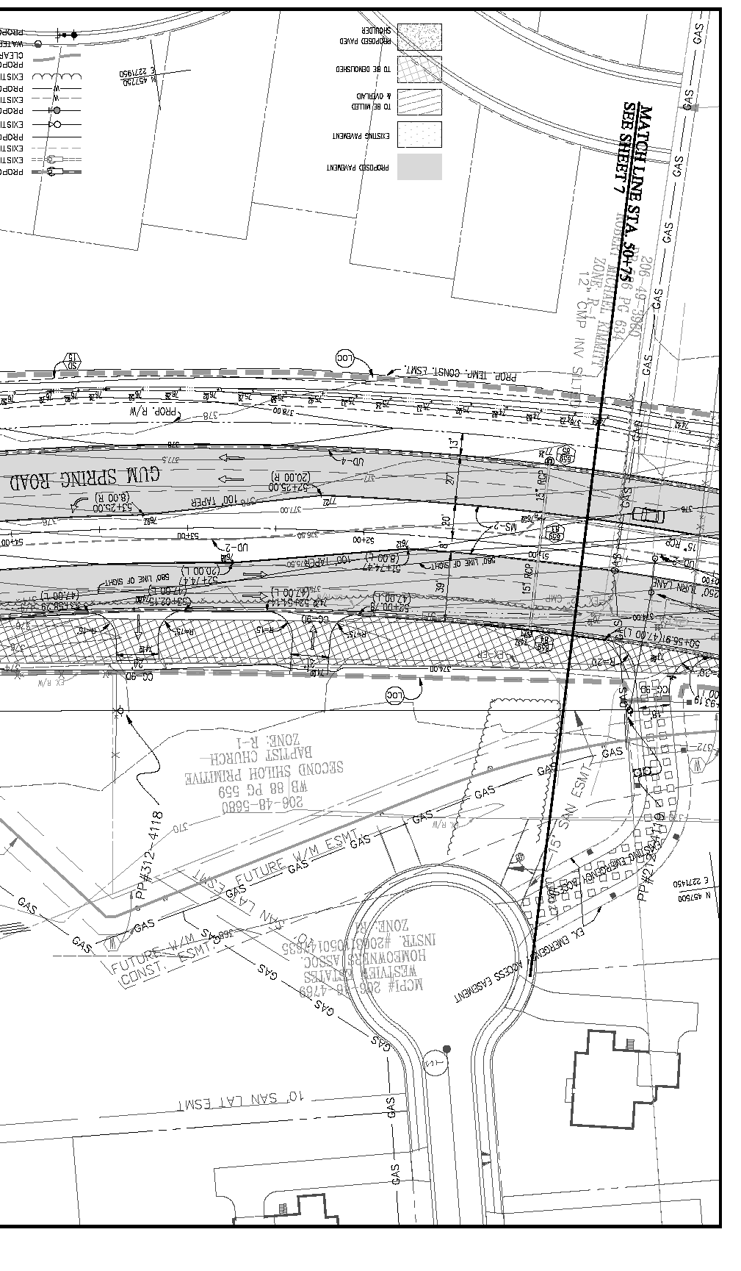
Example of the Need for PTD
Design spec:
  Dig groundwater monitoring wells at various locations.
  Wells located directly under overhead power lines.
Accident:
  Worker electrocuted when his drill rig got too close to overhead power lines.
Engineer could have:
  specified wells be dug away from power lines; and/or
  better informed the contractor of hazard posed by wells’ proximity to powerlines through the plans, specifications, and bid documents.

Slide 22
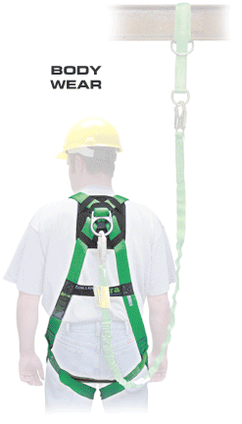
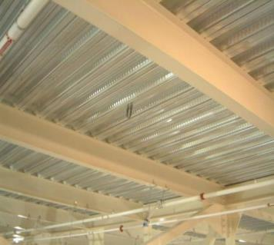
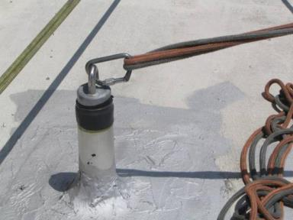
PTD Example: Anchorage Points
Notes:
Need to replace one photo of anchorage point with cad drawing showing anchorage point locations.
Need to add photo of permanent anchorage point on roof.
Identifying and/or designing needed anchorage points for fall protection systems such as body harnesses and lanyards is an example of how designers can use their understanding of structural engineering principles to make it easier for workers to use fall protections systems efficiently, both during construction and future maintenance. Specifically, designers can:
Design floor perimeter beams and beams above floor openings to support lanyards
Design lanyard connection points along the beams
Note on the contract drawings which beams are designed to support lanyards, how many lanyards, and at what locations along the beams.
The idea of identifying anchorage points on construction drawings is in accordance with Appendix C to Subpart M (Fall Protection) from the federal OSHA standards for Construction:
(h) Tie-off considerations (1) “One of the most important aspects of personal fall protection systems is fully planning the system before it is put into use. Probably the most overlooked component is planning for suitable anchorage points. Such planning should ideally be done before the structure or building is constructed so that anchorage points can be incorporated during construction for use later for window cleaning or other building maintenance. If properly planned, these anchorage points may be used during construction, as well as afterwards.”

Slide 23
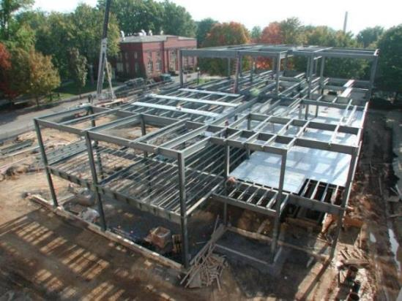
PTD Example: Structural Steel Design
Detailing Guide for the Enhancement of Erection Safety
Published by the National Institute for Steel Detailing and the Steel Erectors Association of America

Slide 24
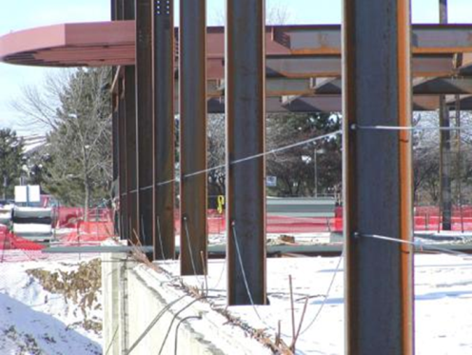
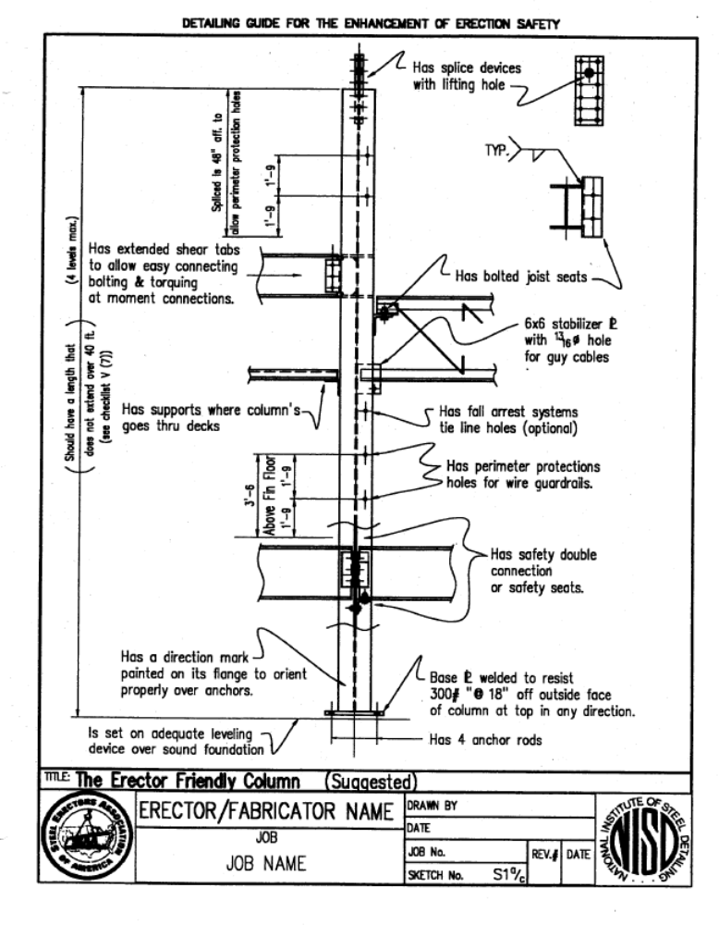
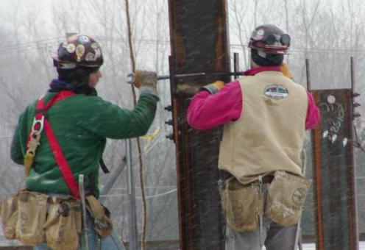
The Erector Friendly Column
  Include holes in columns at 21” and 42” for guardrail cables and at higher locations for fall protection tie-offs
  Locate column splices and connections at reasonable heights above floor
Photo: AISC educator ppt

Slide 25
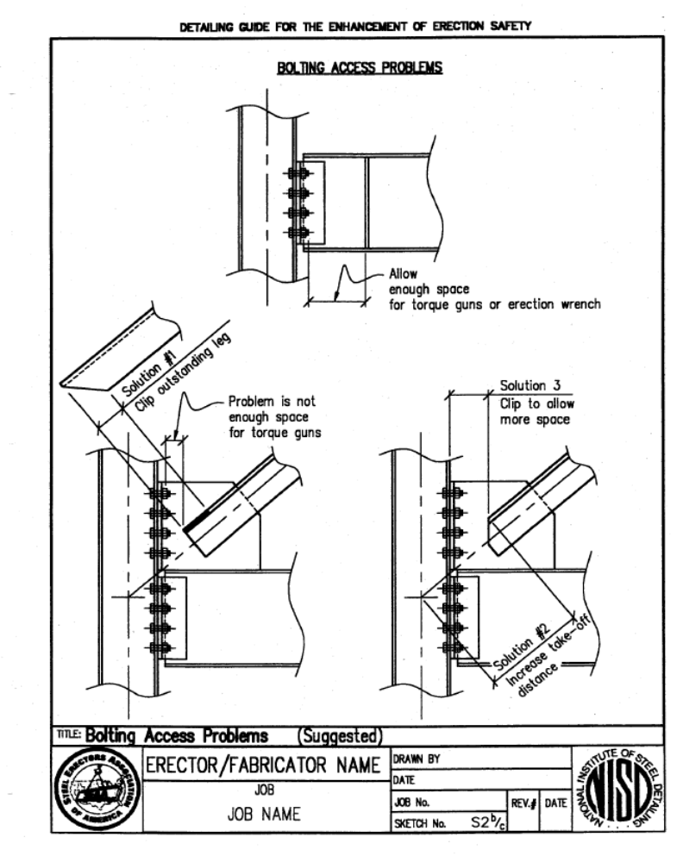
Provide enough space for making connections

Slide 26
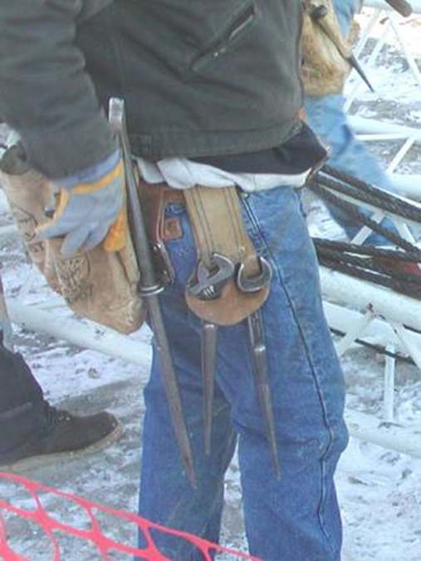
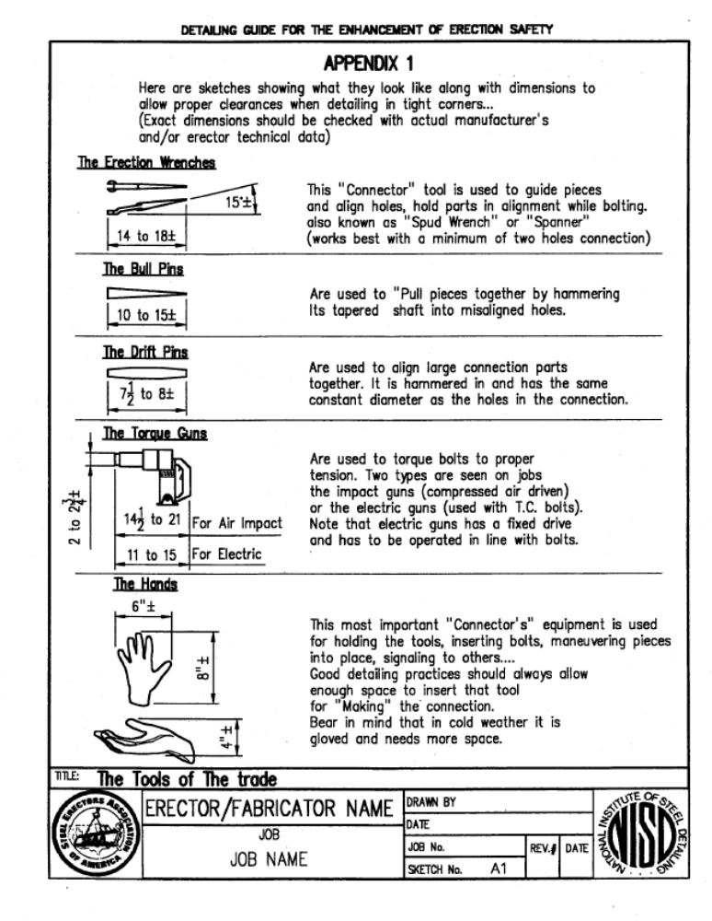
Know approximate dimensions of necessary tools to make connections
Photo: AISC educator ppt

Slide 27
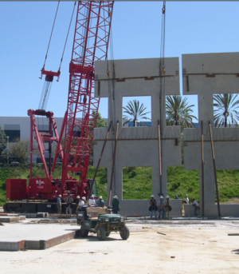
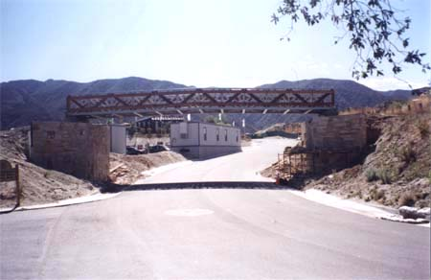
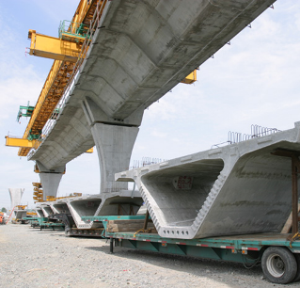
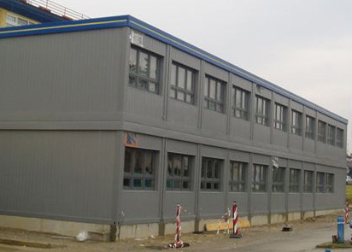
Examples: Prefabrication
Bridge Trusses
Concrete Wall Panels
www.ultimateengineering.com
Pre-engineered buildings
Concrete Segmented Bridge
test.jedinstvo.com

Slide 28
Prefabrication: the link between environmental sustainability and safety
Prefabricated construction is inherently safer than “stick-built.”
Work is shifted from dangerous work environments to engineered work environments and processes.
  at height
  in trenches
  in confined spaces
  exposed to weather (wind, water, ice, mud, lightning)
Prefabricated construction has
  lower construction waste
  lower embodied energy
  lower embodied greenhouse gases

Slide 29
Ptd is gaining momentum
Required in UK, Europe for since 1995
Required in Australia, S. Africa, Singapore
OSHA DfCS Workgroup since 2005
NIOSH PtD Workshops and Funding
ANSI Standard and Technical Report
Adoption primarily in the process/industrial construction sector
ARTBA Initiative
LEED Pilot Credit

Slide 30
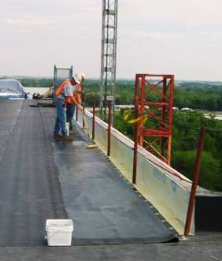
PtD in Practice: Owners
Southern Co.
Intel
San Fran. Public Utilities Commission
BHP Billiton
MWCS
USACE
Notes:
Southern Co: Developed project/equipment-specific and engineering discipline-specific checklists for maintenance that have grown to include construction safety. Safety and construction personnel required to be involved in several design stages. Engineers being trained in safety.
Intel: Has lifecycle safety checklist for all projects. Willing to make major footprint changes, as we saw by adding new floor.
Ellen Stewart at USACE: Intentions but progress limited by focus on completing revised EM 385. PtD and safety promotion to engineering and construction groups and 3 hours of training. She hopes to add anchorage points design to EM 385, processes.
ExxonMobil: Initiated Engineering for Safety Process as part of their Marine Well Containment System (MWCS) project.
Sutter Health: Set up Integrated Project Delivery (IPD) on one of its hospital projects in San Francisco. Co-located owner, designer, CM/GC, and trade contractor firms. IPD process allowed for PtD to occur.

Slide 31
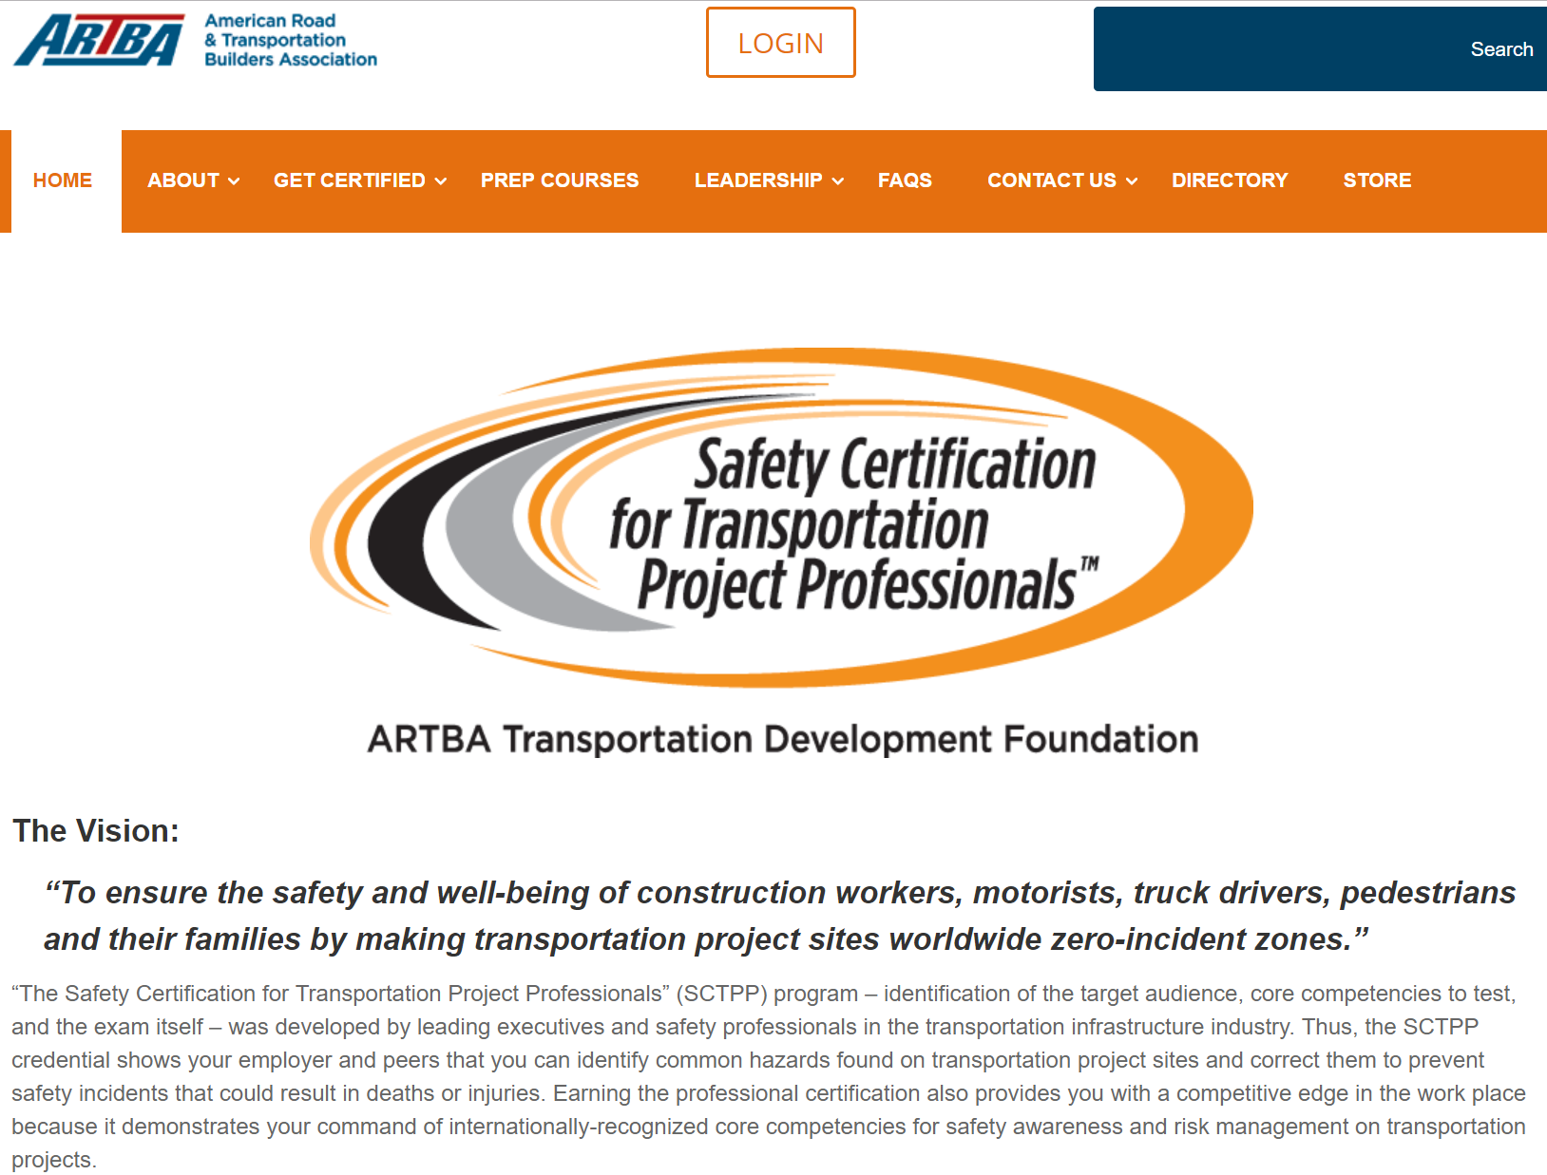

Slide 32
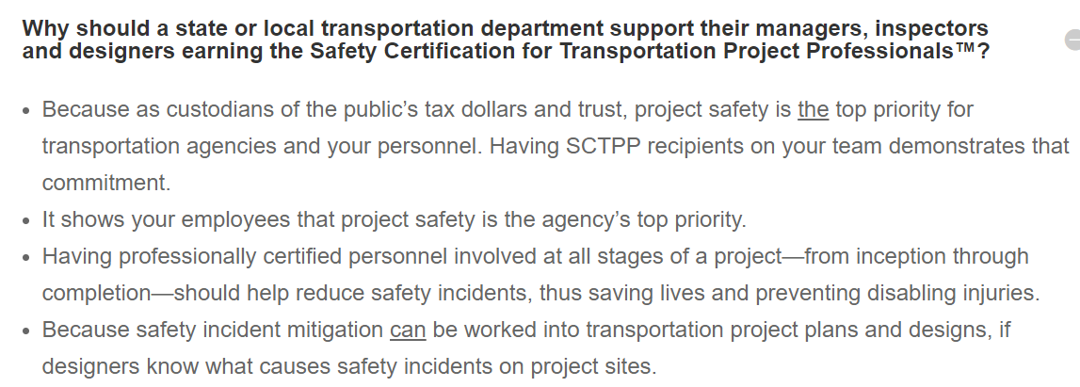
ARTBA Safety Certification FAQ
https://puttingsafetyfirst.org/

Slide 33
LEED PtD pilot credit
Identify and document the items found for the following two stages:
  Operations and Maintenance
  Construction
For each stage, complete three stages of analysis:
  Baseline
  Discovery
  Implementation

Slide 34
Overview
Triple Bottom Line and Social Sustainability
Improving Site Safety requires Integrated Design and Construction
PtD Concept and Benefits
Examples
Processes and Tools
Moving forward in your organization
Prevention through Design
= Design for Safety
= Safety by Design
Processes
Tools and equipment
Products
Work premises and facilities
Work methods and organization of work

Slide 35
Ptd Design Review
Hazard identification
  What construction safety hazards does the design create?
Risk assessment
  What is the level of safety and health risk associated with each hazard?
Design option identification and selection
  What can be done to eliminate or reduce the risk?
  Remember the hierarchy of controls……

Slide 36
LEED CredIt Process
Baseline:
  Describe the baseline assumptions and construction plan for each relevant topic prior to the safety constructability review.
Discovery:
  Describe the key tasks involved with the construction plan for each topic, along with expected hazards and exposures.
  Describe potential strategies identified during the safety constructability review that could be used to eliminate or reduce hazards and exposures for topic area.
Implementation:
  Describe how the safety constructability review resulted in at least one protective measure change made to any of the relevant plans.
    Building and temporary structure design
    Construction Plan
    Construction Safety Plan
    Construction Activity Pollution Prevention Plan
    Construction Indoor Air Quality Management Plan
    Construction and Demolition Waste Management Plan

Slide 37
Construction Elements to be Analyzed and Modified
Site conditions
Building reuse
Construction activity pollution prevention
Construction indoor air quality management
Waste recycling management
Materials and resources
Work at height
Special features

Slide 38
Operations and Maintenance Systems to be Analyzed and Modified
Roof systems
Equipment rooms and systems
Building exterior enclosure and daylighting systems
Storage and collection of recyclables
Special features

Slide 39
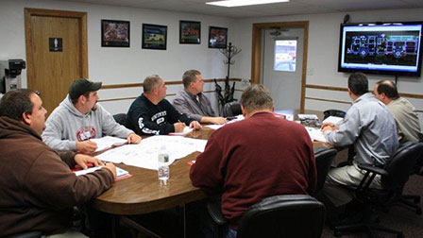
Ptd Process
Get the right people
talking about the right things
at the right time!
www.seagrave.com/

Slide 40
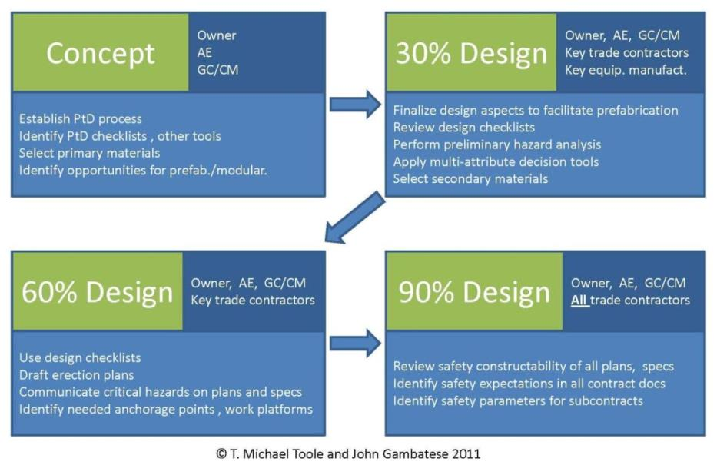
Ptd Process

Slide 41
Ptd Design ChecklistS
Item | Description
1.0 | Structural Framing
1.1 | Space slab and mat foundation top reinforcing steel at no more than 6 inches on center each way to provide a safe walking surface.
1.2 | Design floor perimeter beams and beams above floor openings to support lanyards.
1.3 | Design steel columns with holes at 21 and 42 inches above the floor level to support guardrail cables.
2.0 | Accessibility
2.1 | Provide adequate access to all valves and controls.
2.2 | Orient equipment and controls so that they do not obstruct walkways and work areas.
2.3 | Locate shutoff valves and switches in sight of the equipment which they control.
2.4 | Provide adequate head room for access to equipment, electrical panels, and storage areas.
2.5 | Design welded connections such that the weld locations can be safely accessed.

Slide 42
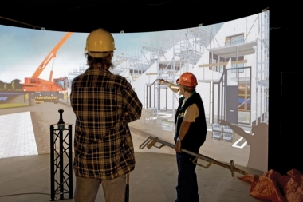
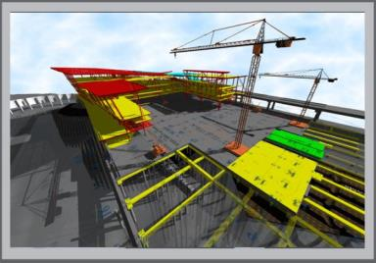
PtD Tools – BIM and Visualization

Slide 43
Overview
Triple Bottom Line and Social Sustainability
Improving Site Safety requires Integrated Design and Construction
PtD Concept and Benefits
Examples
Processes and Tools
Moving forward in your organization
Prevention through Design
= Design for Safety
= Safety by Design
Processes
Tools and equipment
Products
Work premises and facilities
Work methods and organization of work

Slide 44
What ptd in construction is NOT
Having designers take an active role in construction safety DURING construction.
An endorsement of future legislation mandating that designers design for construction safety.
An endorsement of the principle that designers can or should be held partially responsible for construction accidents.

Slide 45
Three Steps towards ptd
Establish a lifecycle safety culture
Establish enabling processes
Team with organizations who value lifecycle safety
Culture
Processes
Partners

Slide 46
Establish a Lifecycle Safety Culture
Secure management commitment to safety and to a life cycle approach
Instill the right safety values
Training
Ensure recognition that designing for safety is the smart thing to do and the right thing to do
  Professional Codes of Ethics
  Payoff data

Slide 47

Establish Enabling Processes
Designer training and tools
Collaborative decision processes
IPD or enabled safety constructability input

Slide 48
Choose your partners wisely
Commitment to safety and to a life cycle approach
Collaborative culture and experiences
Open to change
Negotiated or Cost-Plus contracting

Slide 49
Summary
Our clients and taxpayers may increasingly be demanding that we deliver integrated design and construction and proactively consider the triple bottom line on our projects.
Prevention through Design is a promising way to achieve economic, social and environmental sustainability.
Your firm can become a leader in implementing PtD in their market sectors.
Management commitment, training and client engagement are necessary first steps.

Slide 50
THANK YOU FOR YOUR TIME!
Mike Toole
michael.toole@utoledo.edu
www.designforconstructionsafety.org

Slide 51
Barrier to Ptd: AE Fear of Liability
“The Architect shall not have control over, charge of, or responsibility for the construction means, methods, techniques, sequences or procedures, or for the safety precautions and programs in connection with the Work….” AIA B101-2007, 3.6.1.2
This paragraph is in the construction services section, not in the design services section!
“We need to talk…about safety…during design.”
Drawings, Tech Specs, and constructability discussions with the owner always at least implicitly involve means and methods

Slide 52
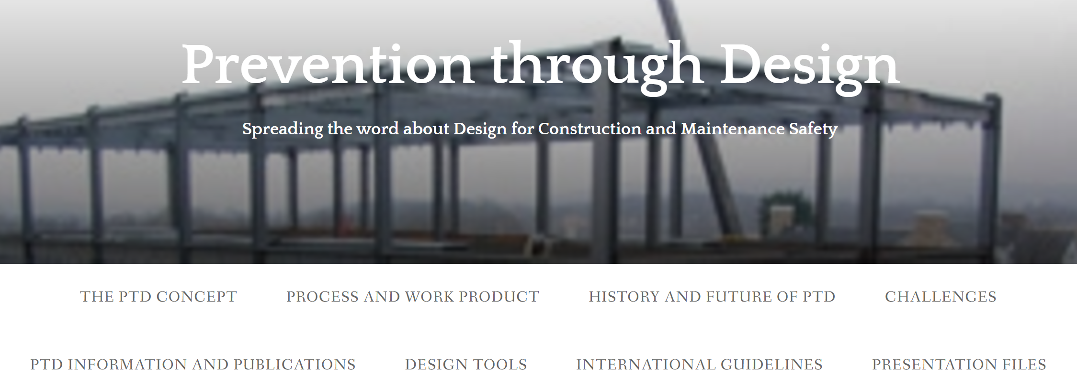
www.designforconstructionsafety.org

Slide 53
Surveys/Interviews of Owners
88% agree with “The benefits of PtD sound like a good idea. I would consider trying it.” OR “PtD sounds like a winner. I have already or will likely try to implement it.”
Percentages of owners who anticipate that PtD would DECREASE:
  Construction injuries = 87%
  The number of lawsuits against owners = 55%
  The number of lawsuits against AEs = 45%
Percentages of owners who anticipate that PtD would INCREASE:
  Design costs = 73%
  Total project costs to the owner= 48%
  Design durations = 62%
  Total design + construction durations = 48%
  Construction quality = 47%
  The reputation of AEs in society = 54%

