Slide 1
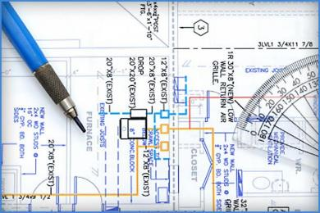

Design for Construction Safety
Notes:
This presentation is not a substitute for any of the provisions of the Occupational Safety and Health Act of 1970 or for any standards issued by the U.S. Department of Labor, nor does mention of trade names, commercial products, or organizations imply endorsement by the U.S. Department of Labor.

Slide 2
Course Goal
The goal is to provide contractors, owners, design/build firms, engineers, architects with information on how to recognize and anticipate construction hazards and how to eliminate them with well thought out design features. Design for Construction Safety course emphasizes permanent design features that eliminate or reduce the risk to hazards.

Slide 3
Specific Course Objectives
Identify factors which contribute to construction injuries and fatalities
Explain how to analyze work sites for hazards
Discuss the hierarchy of controls for construction hazards
Provide methodology and examples of how appropriate design features can eliminate or reduce the risk of an injury

Slide 4
Course Outline
Why Design for Construction Safety (DfCS) is needed
    A. Construction injury and fatality
    statistics
    B. “Conventional” construction
    C. Design for Construction Safety (DfCS)
    overview
    D. Factors that contribute to construction injuries and fatalities, and how DfCS fits in

Slide 5
Course Outline (cont’d)
Design for Construction Safety Methodology
    Identify hazards
1. Consider Human Factors
2. Recognized hazards
3. Hidden hazards-”What if”
    Assess risk associated with each hazard
    Apply Hierarchy of Controls

Slide 6
Course Outline (cont’d)
Top Three OSHA Violations
  Scaffolding
  Fall Protection
  Ladders
Other 1926 Topics
  Confined spaces
  Noise Exposure
  Gases, fumes
  Excavations
  Beams & Columns

Slide 7
Course Outline (cont’d)
Other 1926 Topics (cont’d)
    Overhead power lines
    Sprains, strains, material handling
Life cycle benefits
“The Big Three”

Slide 8
Course Material Includes
Group case study exercises
“What If” analysis exercise
Risk assessment exercise
List of standards
List of references
Design Solution Sheets for Fall Prevention/Protection

Slide 9
Design for Construction Safety (DfCS)
What DfCS is….
  Permanent design features that eliminate a hazard or reduce the risk (i.e., eliminate need for fall protection)
What DfCS is not…
  How to use safety protective devices or procedures (i.e., how to use fall protection)

Slide 10
U.S. Construction Accident Statistics¹
Nearly 228,060 serious injuries and 774 deaths each year
4.2% of workforce but 16.5% of fatalities
Construction has one of the highest fatality rates of any industry sector
¹ Bureau of Labor Statistics-2010

Slide 11
Construction Fatalities By Occupation¹
Total fatalities 774
Foundation, Structure, Exterior
Roofing
Site preparation
Highway, Street, Bridge
Utility Contractors
Electrical
Plumbing, HVAC
Painting, wall covering
¹ BLS,2010
146
89
71
68
67
59
57
37
Notes:
These are some of the construction fatalities based on occupation. As you can see, contractors that work mostly at height have the largest number of fatalities. After that, it is fairly evenly divided among all trades.

Slide 12
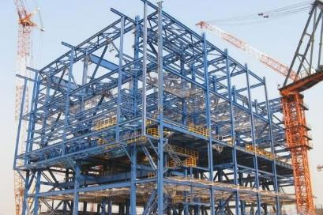
“Conventional” Construction
Design professionals
prepare plans and
specifications so that
the finished building
complies with the
building code.

Slide 13
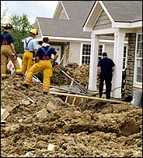
“Conventional” Construction
Hazards are managed
during the construction
process. Little thought
goes into maintaining
the building after the
owner takes possession.
Notes:
Hazards are managed during the construction process. We will see that this is not the most effective time to deal with hazards. There is a better way. Little thought is put into the safe maintenance of the building after the owner takes possession.

Slide 14
Typical Construction Project Arrangement
Project owner separately contracts with a Architect/Engineer and with a general contractor, prime contractor, construction manager, program manager or owner’s agent
Above entities may subcontract out some or all of the work to specialty trade contractors
Project owners occasionally contract with a design-build firm to perform both design and construction
CONSTRUCTION PROJECTS MOVE FAST, SAFETY
RESPONSIBILITIES OFTEN GET BLURRED

Slide 15

Designing For Construction Safety (DfCS)
  The process of addressing construction site safety and health, and planning for future maintenance in the design phase of a project.

Slide 16
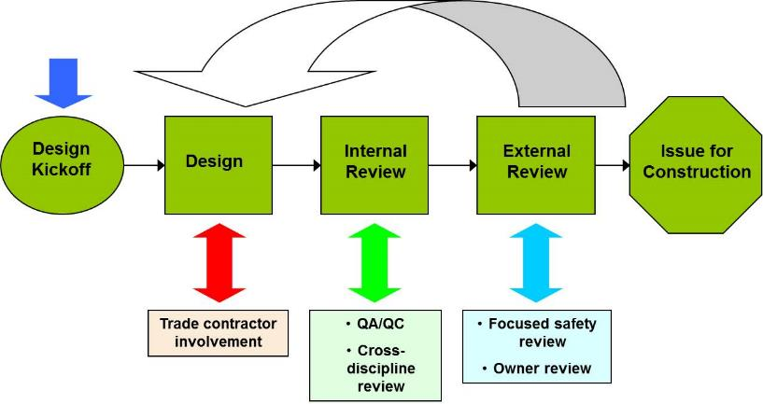
DfCS Process - It’s a Team Concept

Slide 17

Why Is It Necessary?
Currently there are no requirements for construction safety in building codes
IBC Chapter 33 Safeguards during Construction-Pedestrian Safety

Slide 18
Design Can Influence Construction Safety^{1,2}
22% of 226 injuries that occurred from 2000-2002 in Oregon, WA and CA linked to design
42% of 224 fatalities in US between 1990-2003 linked to design
In Europe, a 1991 study concluded that 60% of fatal accidents resulted from decisions made before site work began
¹ Behm, “Linking Construction Fatalities to the Design for Construction Safety Concept”, 2005
² European Foundation for the Improvement of Living and Working Conditions

Slide 19
OSHA 1926 - Engineering Requirements
1926.452 Scaffolds
1926.502 Fall Protection Anchorages
1926.552 Material hoists
1926.652 Excavations
1926.703 Shoring
1926.705 Lift Slabs
1926.850 Demolition preparation
1926.1410 Power lines
1926.1435 Tower cranes

Slide 20
Factors That Contribute to Construction Accidents¹
Inadequate construction planning
Lack of proper training
Deficient enforcement of training
Unsafe equipment
Unsafe methods or sequencing
Unsafe site conditions
Not using safety equipment that was provided
¹ Toole, “Construction Site Safety Roles”, 2002

Slide 21
Where do Design Professionals Fit?
Considering safety issues related to the construction and maintenance of the permanent facility and addressing them during the design stage
Designing out anticipated hazards

Slide 22
Considering Safety During Design Offers the Most Payoff¹
High
Conceptual Design
Detailed Engineering
Ability to Influence Safety
Procurement
Construction
Start-up
Low
Project Schedule
¹ R. Szymberski, “Construction Project Safety Planning” TAPPI Journal, 1997.

Slide 23
DfCS Methodology
Step 1: Identify/anticipate
potential hazards
Step 2: Assess the risk for each
hazard
Step 3: Apply Hierarchy of
Controls
Step 4: Review drawings with
contractors and owners
for additional input
Step 5: Issue drawings for
construction

Slide 24
Step #1
Identify/Anticipate Potential Hazards

Slide 25
Consider Human Factors
Sequencing of work (can create unplanned hazards)
Worker misjudges a situation
Deficient management
Distractions
Perception errors
Lack of training
Lack of equipment (for example, no place to tie off, worker makes do)

Slide 26

Recognized Hazards

Slide 27
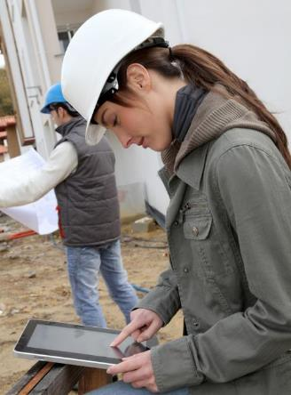
Visit Similar Facilities

Slide 28
Recognized Hazards - Sources
Industry Standards
ANSI
ASTM
NFPA
National Safety Council
MSHA
SAE
NIOSH
US Army Corps of Engineers
ACI

Slide 29
Recognized Hazards - Sources
Government Regulations
OSHA 1910 General Industry
OSHA 1926 Construction
Federal Motor Carrier Safety Regulations
Notes:
These are some of the government agency regulations that can be referred to help with recognized hazards.

Slide 30

Hidden Hazards
Notes:
Then there are “hidden” hazards. “Hidden” hazards are just what the name implies. They are not readily apparent. These are hazards that can arise from complex interactions or scenarios. For example, a work task is taken out of sequence.. A siding contractor shows up before scaffolding is put in place. “Hidden” hazards can also be latent. One sub-contractor walks down a planked walkway not knowing that a second sub-contractor has not finished putting the planks down.

Slide 31
Examples of Hidden Hazards
Underground utilities
Electrical wire buried in a wall
Asbestos
Rot/Decay of structural members
Gas lines
Any hazard uncovered during project execution

Slide 32

”What If” Analysis

Slide 33
Hidden Hazards -”What If” Analysis
A “What If” analysis is a structured brainstorming methods of uncovering hidden hazards
Select the boundaries of the review
and assemble an experienced team
Gather information-video tapes of operation, design documents, maintenance procedures, etc.

Slide 34
“What If” Situation Questions
Failure to follow procedures
Procedures are followed, but are incorrect
Equipment failure
Utility failure
Weather
Operator not trained

Slide 35
“What if” Analysis Template
What if? | Answer | Likelihood | Consequences | Recommendations

Slide 36
Hidden Hazards -”What If” Analysis Example
Highway Construction Project-
What if workers have to access drains? Are drains a possible confined space?
What about the power lines? Will equipment be operating near power lines?
What about worker/public injury from traffic accidents? Do trucks have enough turning space? Is there signage/barriers to re-direct pedestrians?
Will construction vehicles have enough shoulder space to stop on road
What if worker attempts to manually pick up drain covers? Are they lightweight? Do they have handles?

Slide 37
Hidden Hazards - Other Methods
Fault Tree Analysis
Design Check Lists
Plan review, if your gut feeling tells you that something is unsafe, it probably is.
Read case studies on construction accidents
“Fatal Facts”
NIOSH “FACE” reports

Slide 38
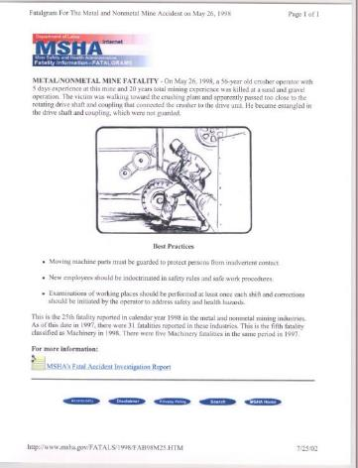
Fatal Facts

Slide 39
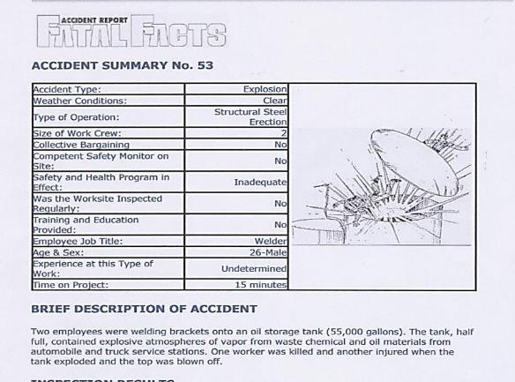
Fatal Facts

Slide 40
Step #2
Assess the Risk for Each Hazard

Slide 41
DfCS - Risk Assessment Estimate Injury Severity
Severe-Death or serious debilitating long-term injury such as amputation or coma
Serious-Permanent or nonreversible injury that severely impact enjoyment of life and may require continued treatment

Slide 42
DfCS - Risk Assessment Estimate Injury Severity
Moderate-Permanent or reversible minor injury that does not significantly impact enjoyment of life, but requires medical treatment.
Slight-Reversible injury requiring simple medical treatment with no confinement

Slide 43
DfCS - Risk Assessment Estimate Probability of Hazardous Event
High- Very likely to occur, protective measures are nearly worthless
Medium-Occurrence is likely. The frequency of control measures is significant or control measures are inadequate

Slide 44
DfCS - Risk Assessment Estimate Probability of Hazardous Event
Moderate-Occurrence is possible, but not likely
Low- Occurrence is so unlikely as to be considered nearly zero.

Slide 45
DfCS - Risk Assessment Matrix
Probability | Severity
 | Severe | Serious | Moderate | Slight
High | High | High | Medium | Low
Medium | High | Medium | Low | Low
Moderate | Medium | Low | Low | Negligible
Low | Low | Low | Negligible | Negligible

Slide 46
Step #3
Apply Hierarchy of
Controls

Slide 47
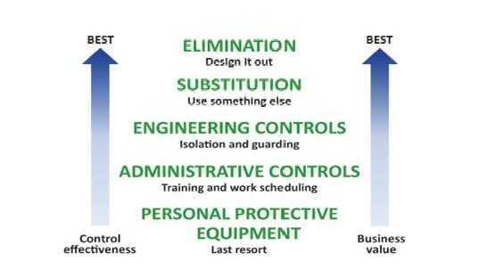
Hierarchy of Controls
Ref: Peterson JE , 1973. Principles for controlling the occupational environment. The industrial environment—its evaluation and control. Cincinnati, OH: U.S. Department of Health and Human Services, Centers for Disease Control and Prevention, National Institute for Occupational Safety and Health, DHHS (NIOSH), p 117.

Slide 48
DfCS Template
 | Practical |  |  |  | Practical |  | All Practical |  | Controls
 | Significant |  | To Eliminate |  | To Isolate |  | Steps to Minimize
Hazard | Yes | No | Yes | No | Yes | No | Yes | No | Required
Notes:
Here is a template that you can use for DfCS.

Slide 49
Top Ten 1926 OSHA Violations
1) Subpart M .501(b)(13) – Fall Protection – Residential Construction
2) Subpart X .1053(b)(1) – Portable ladders not extended 3 feet above landing
3) Subpart M .501(b)(1) – Fall Protection – Unprotected Sides & Edges
4) Subpart M .503(a)(1) – Fall Protection – Training
5) Subpart E .102(a)(1) – Eye and Face Protection
6) Subpart E .100(a) – Head Protection
7) Subpart L .451(g)(1) – Scaffolds – Fall Protection
8) Subpart L .453(b)(2)(v) – Aerial lifts – Fall Protection
9) Subpart L .451(e)(1) – Safe Access
10) Subpart M .501(b)(10) – Fall Protection – Low-sloped Roofs

Slide 50
1926.501 Fall Protection
Falls consistently account for the greatest number of fatalities in the construction industry each year
In 2013 the falls, slips, or trips resulted in 699 fatalities. Falls to lower level accounted for 82% of those fatalities.
Approximately 1 in 4 of those fatalities occurred from a fall of 10 feet or less.
Source: www.bls.gov/new.release/pdf/cfoi.pdf

Slide 51
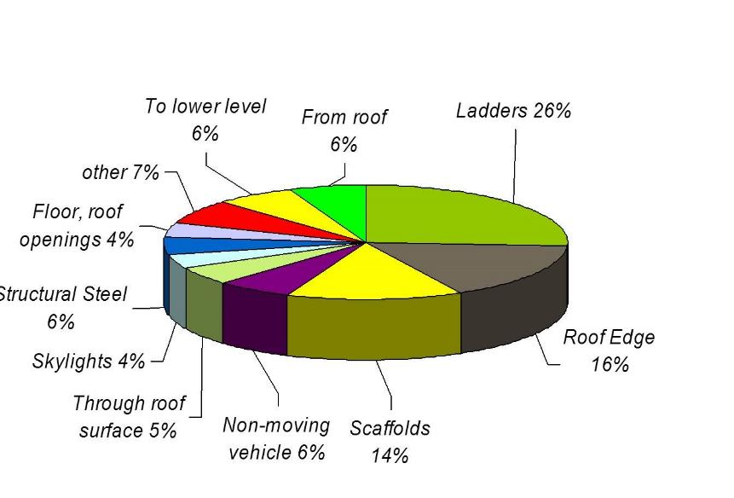
Fatal Falls Most Often From
Source – BLS Data, 2010

Slide 52
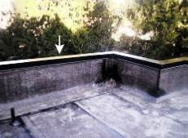
Consider Parapets
A parapet that can function
as a perimeter guard also
eliminates the need to
provide temporary fall
protection for construction
and maintenance activities on the roof thus reducing total costs over the building life cycle.

Slide 53
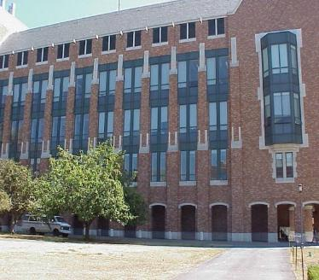
Specify Window Sills at 42 inches
If window sills are specified at a height of 42 inches plus or minus 3 inches… temporary guardrails would not be required

Slide 54
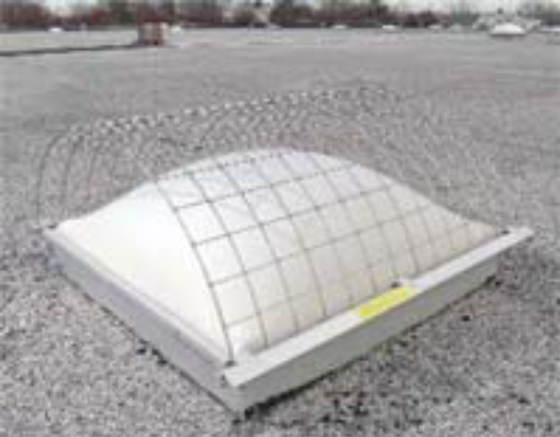
Skylights
Specify products that can
withstand the live load
associated with a construction or maintenance worker inadvertently stepping on or falling on a skylight.
An alternative approach is
to specify that guards or
screens designed to handle these loads be attached over each skylight

Slide 55
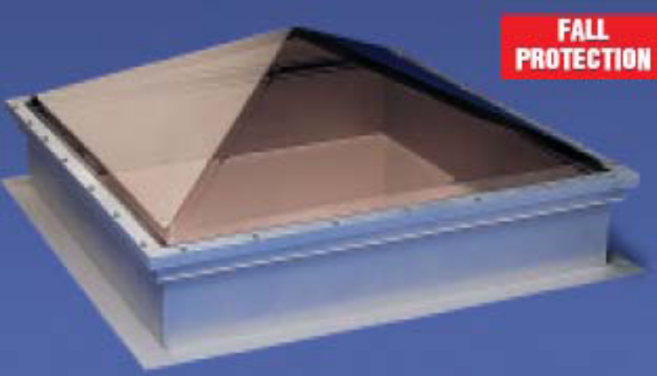
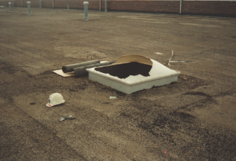
Skylights
Consider specifying skylights that can withstand human impact loads.
So that this does not happen

Slide 56
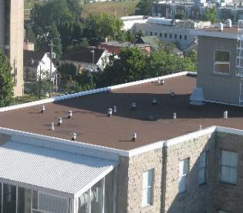
Permanent Roof Anchors
Permanent anchors provide a convenient, safe place to tie off when personal fall arrest systems are needed. They also reduce the chance a worker will not use a personal fall arrest system because there is no approved place to anchor, or the worker connects to something that may not be structurally sound or certified by a registered Professional Engineer (PE).

Slide 57
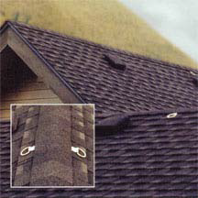
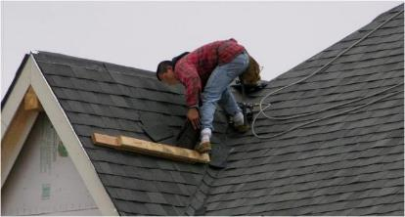
Permanent Roof Anchors
Consider permanent roof anchors
So that a roofer has a convenient anchor to tie off

Slide 58
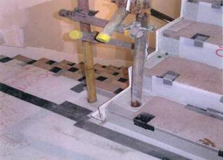
Stairways and Floor Openings
Cast-in sockets can be specified around floor openings and stairways. The sockets make it easy for contractors to install temporary guardrails during the construction phase. The sockets can then be used for permanent railings or filled in.

Slide 59
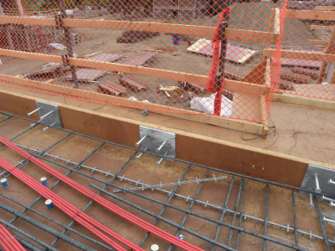
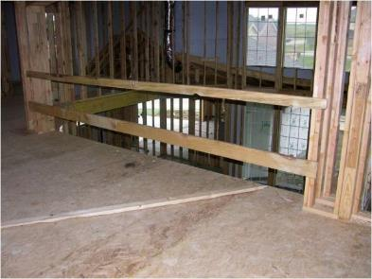
Floor Openings/Open-Sided Floors
Consider imbedded steel plates that can be used for temporary guardrails and later used for permanent wall systems.
So that this does not happen

Slide 60
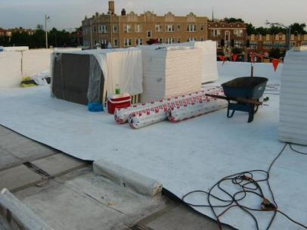
Falls Through Roof Surface
Anticipate materials that may be stored on a roof during construction. Specify roof structure to support the dead load of construction materials.

Slide 61
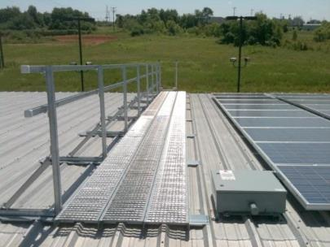
Falls Through Roof Surface
Consider adding a safe catwalk to your plans so that workers and future maintenance personnel with have a structurally sound and safe surface to walk on when on the roof.

Slide 62
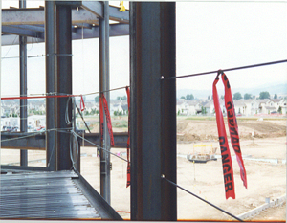
Falls from Open Sided Floors
Specifying holes in
columns at 42 inches
plus or minus 3 inches
and 21 inches above
each floor slab make it
easy to install cable or
wire perimeter cables.

Slide 63
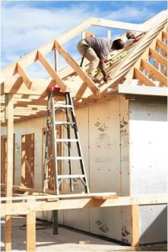
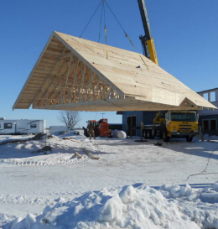
Reduce Work at Elevations
Specifying roofs built on the ground and hoisted into position
So that workers don’t have to stick build them at elevation
Notes:
Less time spent at height means fewer fall accidents. The more that can built on the ground then hoisted into place means less time working at height. Consider modular construction. This slide shows a roof system that was built on the ground then hoisted into place as opposed to the conventional method on the right where workers are at height, most likely without fall protection, stick building the roof.

Slide 64
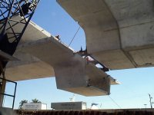
Reduce Work at Elevations
Segmented
Bridge sections

Slide 65
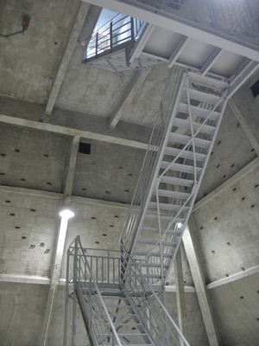
1926.1053 Ladders
Designers should consider specifying fixed ladders or
stairways whenever possible. This would eliminate the need for a portable ladder when
accessing a roof, work platform, mezzanine, or upper level.

Slide 66
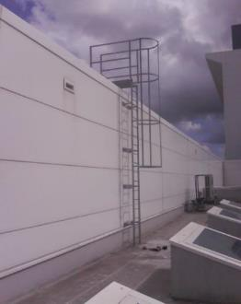
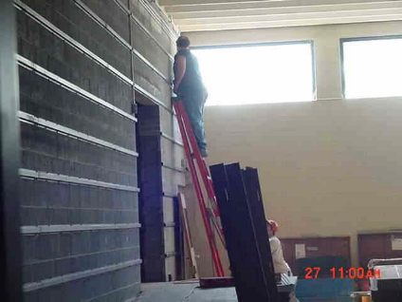
1926.1053 Ladders
Specify a safe fixed ladder
Eliminate the need for portable ladders

Slide 67
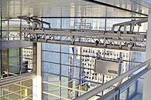
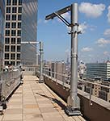
1026.451 Scaffolding
Gantry systems can be designed to maintain atriums and skylights
Davits can be installed to provide a permanent suspension system.

Slide 68
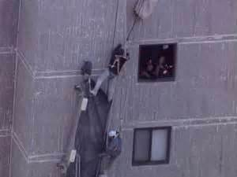
1026.451 Scaffolding
Consider eliminating the need for scaffolding or design permanent anchor systems so that this does not happen

Slide 69
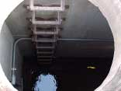
1926.21(b)(6) Confined Spaces
Try to avoid
designing
confined spaces

Slide 70
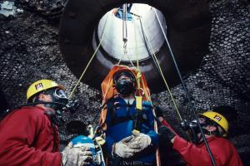
1926.21(b)(6) Confined Spaces
So that a worker’s life does not depend on confined space entry permit

Slide 71
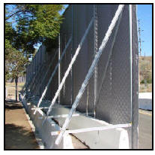
1926.52 Noise Exposure
Specify sound barriers at the site. Sound barriers can be constructed on site from scrap materials such as plywood. Commercial sound panels that are lined with sound absorbing material can also be used.

Slide 72
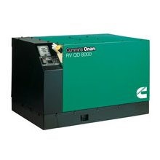
1926.52 Noise Exposure
Specify quiet equipment such as pumps, generators, and compressors that don’t require hearing protection when working around them.

Slide 73
1926.52 Noise Exposure
OTHER CONSIDERATIONS:
Design cast crack inducers in concrete to avoid the need to saw cut joints
Design cast-in anchors instead of drill and fix
Avoid vibro compacting
Detail mesh reinforcement to suit bay sizes, rather than cutting to fit on site
Specify non standard blocks to be cut off site under controlled conditions

Slide 74
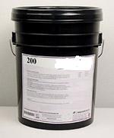
1926.55 Fumes
Specify primers, sealers and other coatings that do not emit noxious fumes or contain carcinogenic products

Slide 75
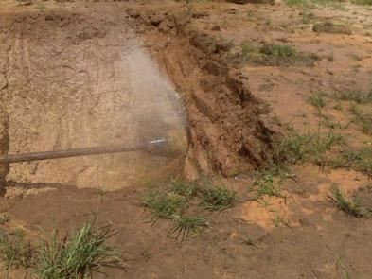
1926.652 Excavations
Design underground utilities to be placed using trenchless technology

Slide 76
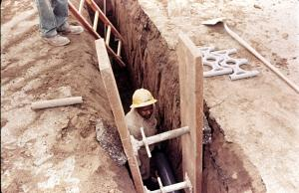
1926.652 Excavations
Why take the
chance of a
trench collapse?

Slide 77
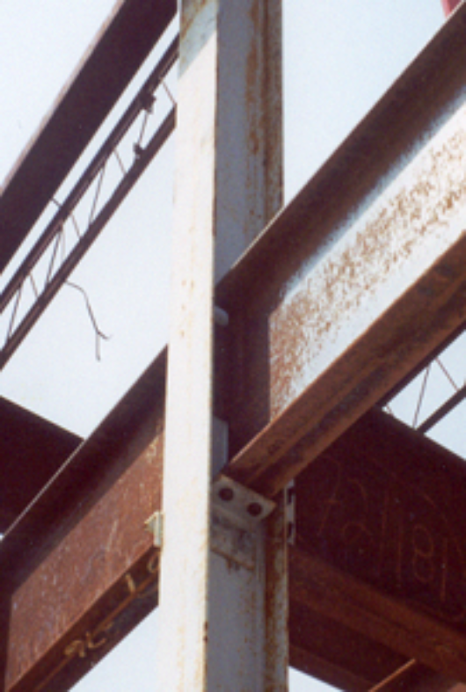
1926.756 Beams & Columns
Designers can specify features that make it safer and easier to erect structural steel. For example, hanging connections should be avoided. Safety seats at column connections would eliminate this by providing support for girders during the connection process.

Slide 78
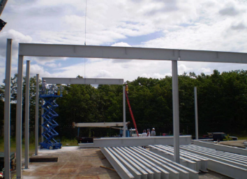
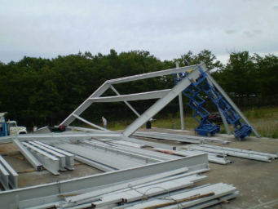
1926.756 Beams & Columns Cont’d
Specify bracing on the bid documents
So that this does not happen

Slide 79
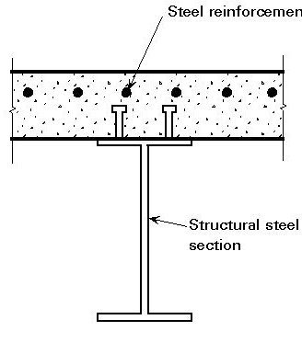
1926.756 Beams & Columns Cont’d
Non composite beam design during construction for construction live loads
Composite beam design for final condition

Slide 80
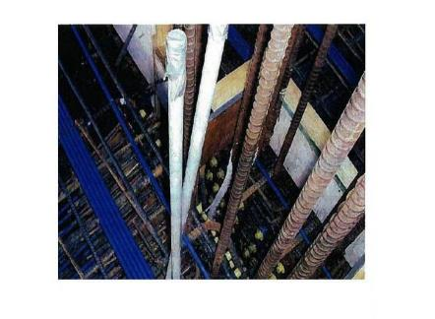
1926.756 Beams & Columns Cont’d
Show rebar details at
beam column joints to
avoid congestion of
rebars and to prevent
honeycombing (voids)
into concrete

Slide 81
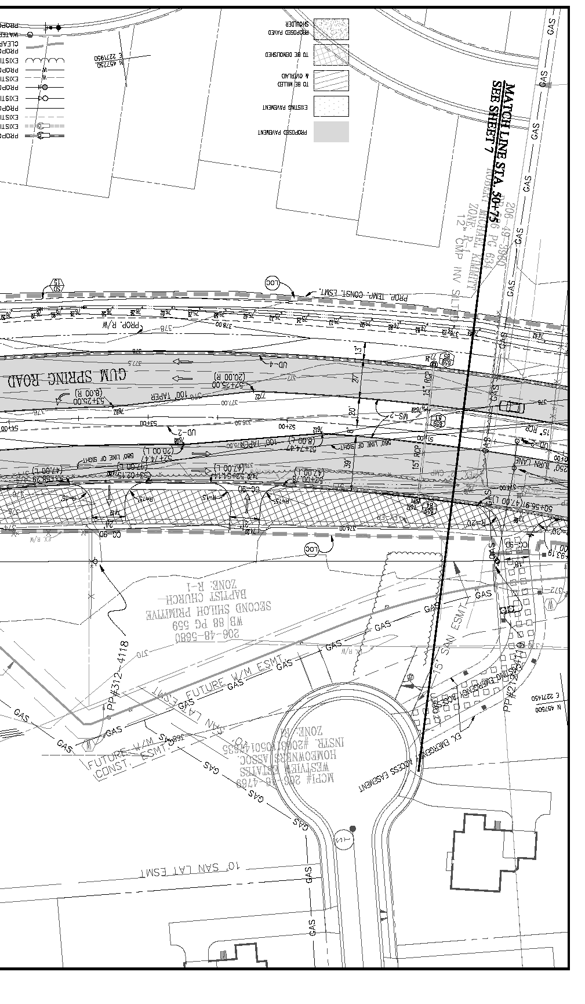
1926.955 Overhead Power Lines
Consider the use of cranes and drilling rigs near power lines.
Do not specify ground water monitoring wells or other facilities near or under power lines.

Slide 82
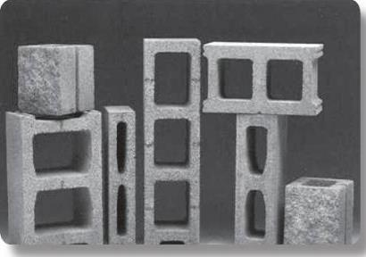
Sprains, Strains, Material Handling
Consider specifying
lightweight concrete
block whenever
structurally feasible

Slide 83
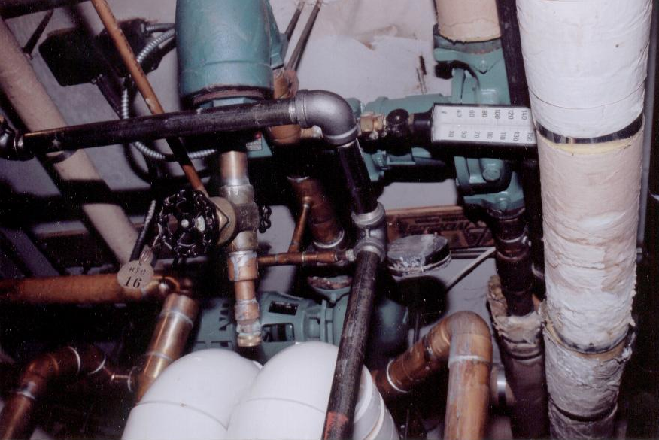
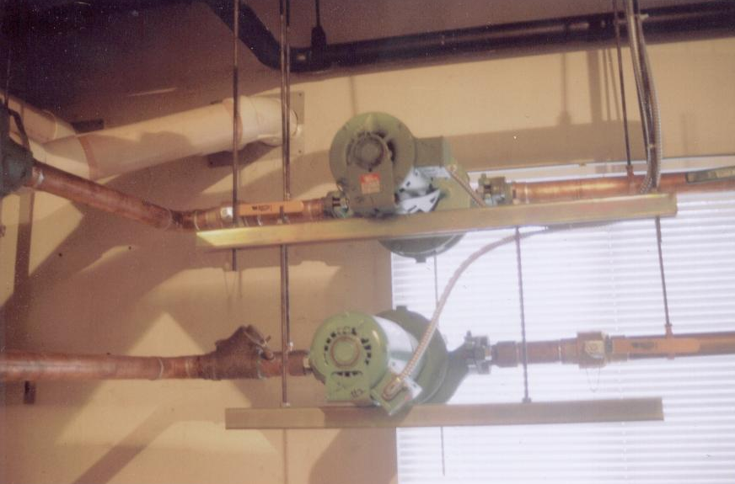
Sprains, Strains, Material Handling
Which pump installation is easier to maintain?

Slide 84
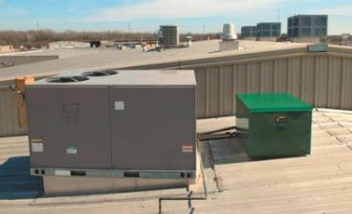
Other Benefits of DfCS
Positioning equipment at least 15 feet back from the roof edge will reduce the risk of falling when installing and servicing the equipment

Slide 85
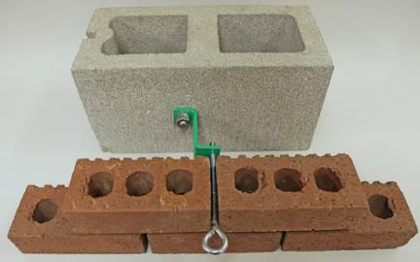
Other Benefits of DfCS
Specify building ties that are easier to remove and can be reused.
Notes:
Here is an example of roof ties that are easy to remove, and can be re-used in the future if scaffolding has to be erected to maintain the exterior.

Slide 86

Other Benefits of DfCS
    Specify quieter
    equipment and/or
    noise control in
    mechanical rooms
    so that hearing
    conservation
    Programs will not be required

Slide 87


Other Benefits of DfCS
Specify this…
...So that you don’t have to do this later

Slide 88

Other Benefits of DfCS
Specify Arc
Resistant
Switchgear
Floyd, H. (2011) Progress in impacting policy in workplace safety NIOSH PtD conference, 2011.

Slide 89


Other Benefits of DfCS
Specify “smart” substations
So that you can do this…..
Instead of this…….
Floyd, H. (2011) Progress in impacting policy in workplace safety NIOSH PtD conference, 2011.

Slide 90
Course Summary
During this session, you have been introduced to:
Factors which contribute to construction injuries and fatalities
How to analyze work sites for hazards
Hierarchy of controls for construction hazards
Methodology and examples of how appropriate design features can eliminate or reduce the risk of an injury

Slide 91
Always Consider the “Big Three”
Fall - Design the building so that fall protection is not needed
Scaffolds - Design building so that scaffolds are not needed or provide solid structures from which scaffolds can be suspended
Ladders - Design the building so that portable ladders are not needed.

Slide 92

OSHA Resources

Slide 93

Thanks for Your Participation

